Slide 1
Informatics 43 – May 26, 2016

Slide 2
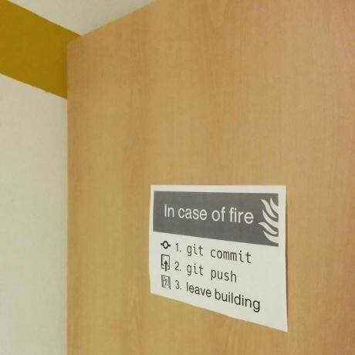

Slide 3
Architectural Styles and Patterns
A named, commonly used set of
Components – subsets of functionality (we are concerned with what a component does, not how it is implemented) – aka modules
And
Connections – function calls, shared memory, network traffic (message passing), sequencing, roles

Slide 4
Pipes and filters – Unix command example
tr 'A-Z' 'a-z' <myfile.txt |
tr -c 'a-z' '\n' | sort | uniq > w.txt
tr “translate” uppercase to lower case
tr turn everything except lowercase (‘-c’ means
‘complement’) to newline
sort puts words in alphabetical order
uniq gets rid of duplicates

Slide 5
myfile.txt:
What I said, what SHE said, what she said I said!!!
what i said, what she said, what she said i said!!!
what i i
i i said
said said she
what said what w.txt
she said
said said
what she
she she
said what
i what
said what

Slide 6
Styles from last two lectures
Client – Server
Typically, the client and the server are separate computers that communicate over a network.
3-tier / n-tier
A generalization of client-server. Each tier has one or more computers that communicate with adjacent tiers.
Pipes and filters
Each format of the input and output are the same for every filter, so the order of the filters can easily be rearranged.

Slide 7
Styles from last two lectures
Event driven
The system reacts to events (which usually come from outside the system.
Layered
Typically, the modules in the various layers are all on one computer. Modules on one layer are implemented by calling functions from the layer below.

Slide 8
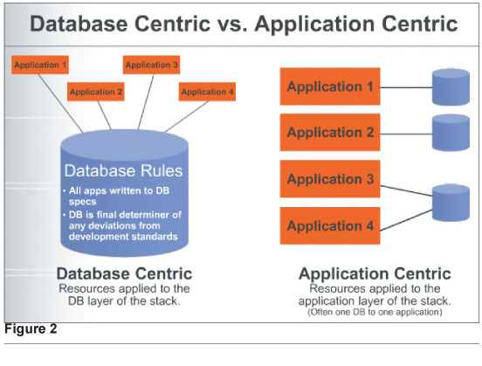
Database-centric

Slide 9
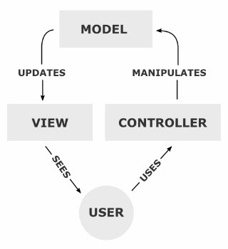
Model View Controller Architecture
View components present information to the user.
Models store information and hold business rules.
Controllers tell views and models to update.

Slide 10
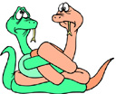
Model View Controller Architecture
Key benefits (from Ian Davis):
Decouples model and view – one model can support multiple views.
Decouples view and controller – can change the way a view responds to user input.

Slide 11
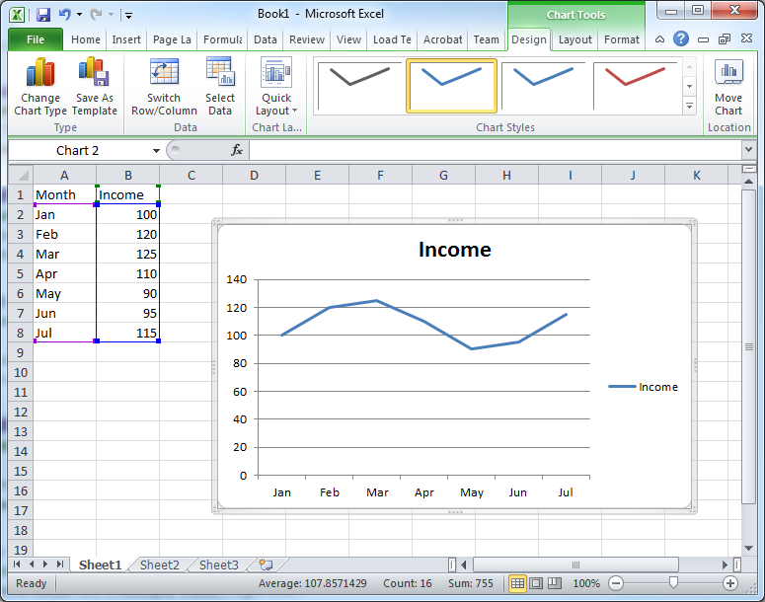
Model View Controller Architecture

Slide 12
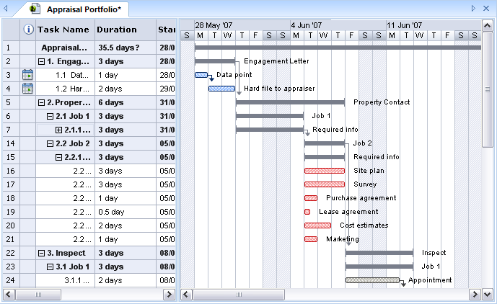
Model View Controller Architecture

Slide 13
Model View Controller Architecture
People interpret “Controller” in different ways.

Slide 14
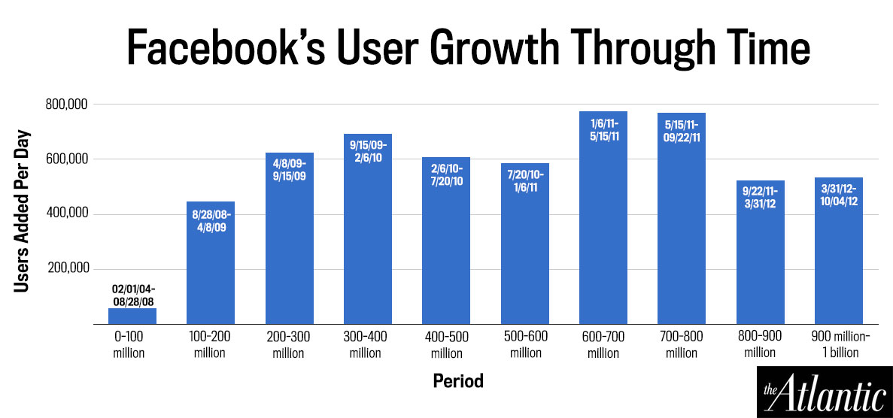
Facebook has over 1 billion users!

Slide 15
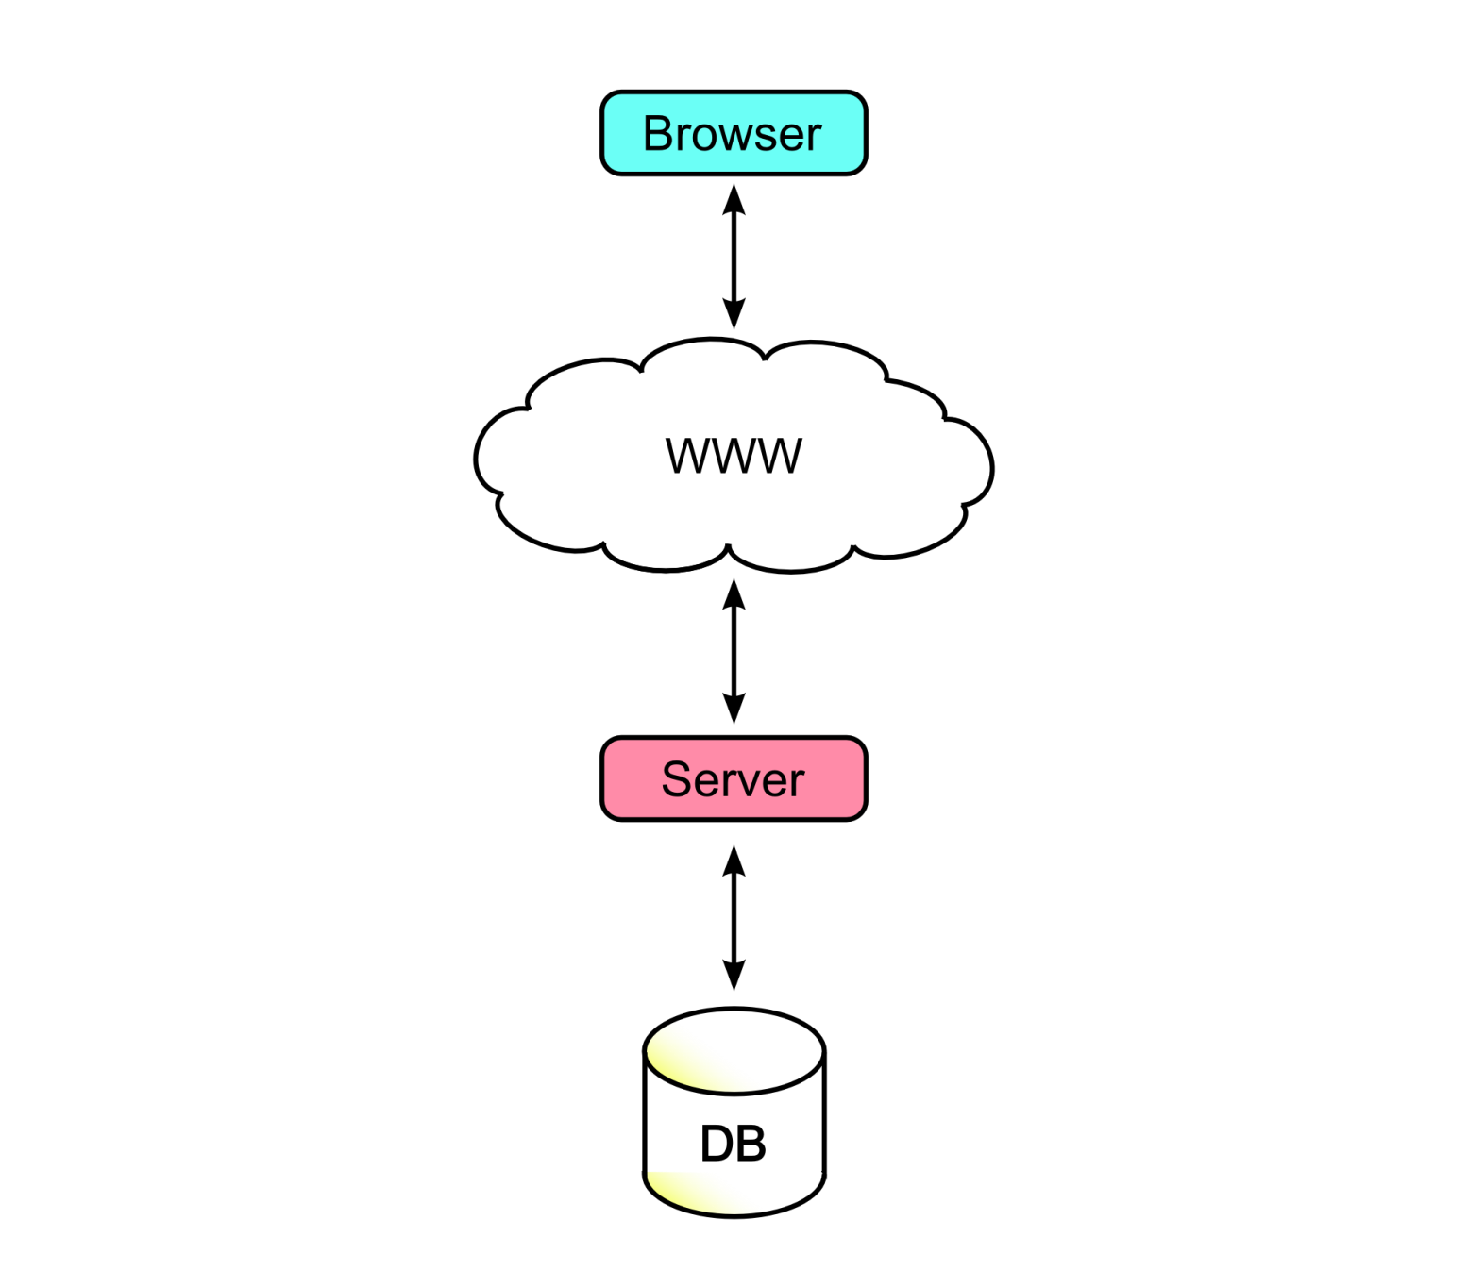
Does Facebook only have one server?

Slide 16
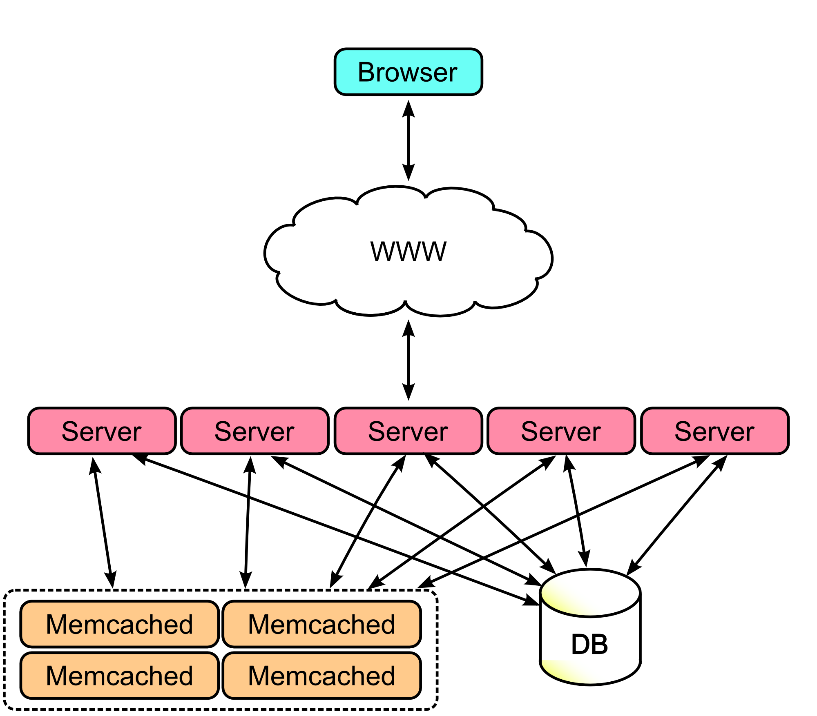
Notes:
Multiple servers. Why?

Slide 17
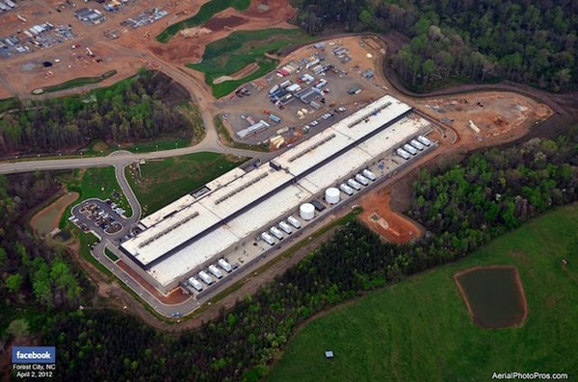
Facebook has LOTS and LOTS of servers.
>180,000 servers across multiple data centers.

Slide 18
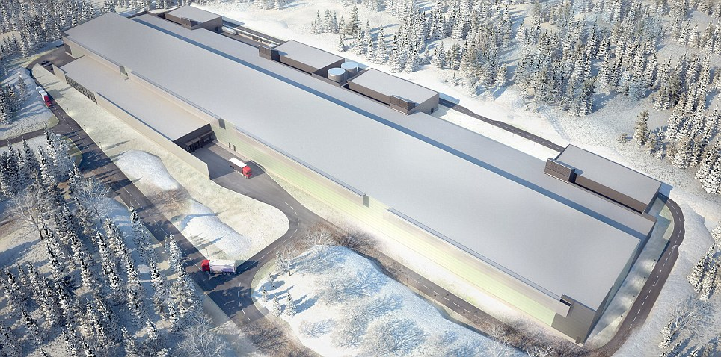
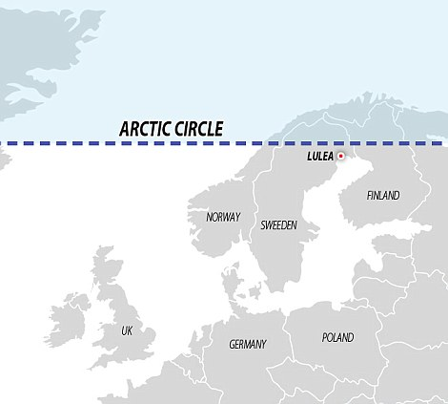

Slide 19
What do software architects do?
Figure out non-functional requirements
Figure out what the components should be and how they communicate – select and modify architectural styles.
Instruct programmers
Design tests
Code (yes, software architects code)

Slide 20
Architectural Style Recap
Client-Server
n-tier (3-tier)
Pipes and filters
Event driven
Layered
Database centric
Model View Controller (MVC)
these are not completely distinct, these are not orthogonal, and they are not all addressing the same scale of software system

Slide 21
“Where do they find the time?”
Clay Shirky: Cognitive Surplus
Part 1: https://www.youtube.com/watch?v=AyoNHIl-QLQ
Part 2: https://www.youtube.com/watch?v=jNCblGv0zjU

