Slide 1
Informatics 43 – May 24, 2016

Slide 2
The Design Phase of Software Development
Something usually needs to be done after the user’s requirements are specified and before coding starts, especially on larger tasks.
Modularize the task so that multiple people can work on it.
Define modules and their interfaces.
Make system-wide decisions.
Architecture, languages, libraries, platforms.
Develop the specifications in more detail.
More “how”; consideration of trade-offs.

Slide 3
The Design Phase of Software Development
Architectural Design
High level overview (textbook)
The structure(s) of a system (Bass et al. in textbook)
The principle design decisions about a system (ISR at UCI)
The skeleton of a system (Razzie)

Slide 4
Architectural options for mail
Person to person, via a carrier, receiver pays
Person to post office to central post office to local post office to person, sender pays (“penny stamp”)

Slide 5
The following 3 slides are borrowed from Prof. Andre van der Hoek, who has taught this class in the past.

Slide 6
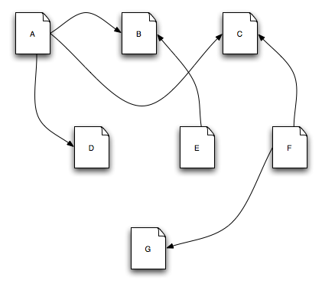
Architecture in action: WWW
This is the Web
Each node is a web page.

Slide 7
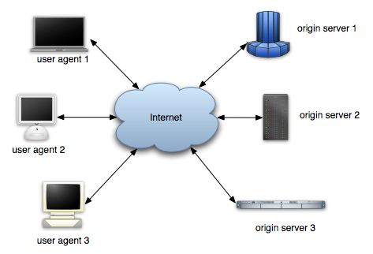
Architecture in action: WWW
So is this
Origin server: a server (computer) on which a resource resides. User agent: browser.

Slide 8
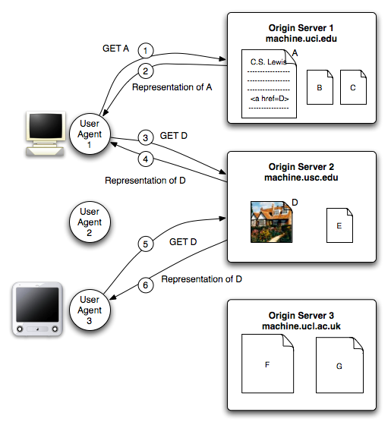
Architecture in action: WWW
And this
Focus on what messages are transmitted between servers and user agents.

Slide 9
Architectural Styles and Patterns
Collections of decisions that work well together.

Slide 10
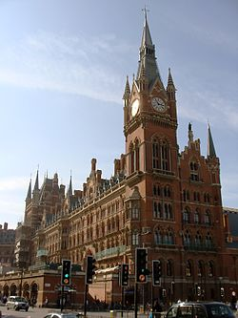
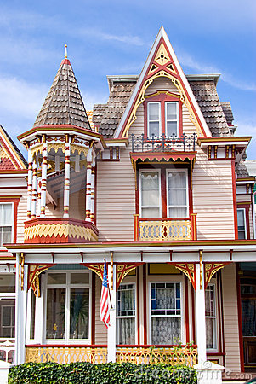
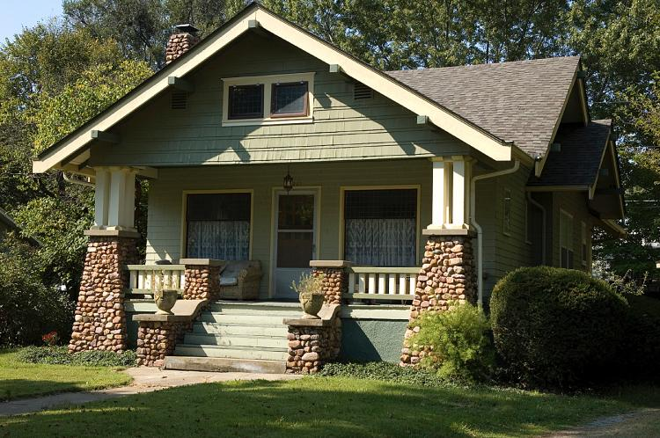
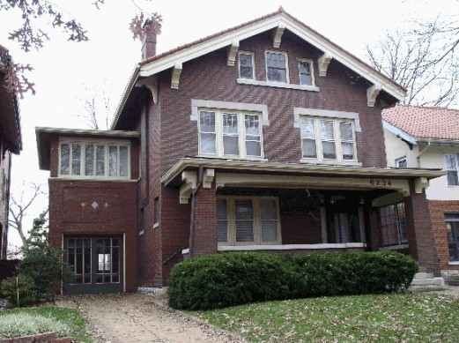
Architectural Styles
Victorian:
Arts and Crafts:

Slide 11
Architectural Styles and Patterns
A named, commonly used set of
Components – subsets of functionality (we are concerned with what a component does, not how it is implemented) – aka modules
And
Connections – function calls, shared memory, network traffic (message passing), sequencing, roles

Slide 12
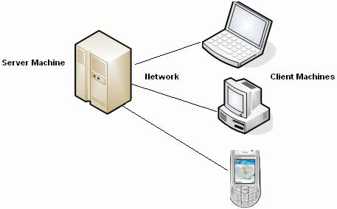
Client – Server Architecture revisited
A server computer (or process) has computational or memory resources that it provides to one or more
client computers (or processes), typically over a network.

Slide 13
Client – Server Architecture
What might a client request from a server?
Data – shared, real time / sensor
IP addresses
Verification of data (security, pirating)
Software updates
Computation
Web pages
Time of day

Slide 14
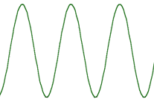
Client – Server Architecture
In Apple’s Siri, the steps are
Sound waves (voice) -> text
Text -> query
Query -> answer
Answer -> Response text
Response text -> sound waves
“Who is the president of the United States?”
FIND(“USA”, “President”)
Barack Obama
“The answer is Barack Obama”
Which parts are computed on the client, which parts on the server?

Slide 15
Client – Server Architecture
In the World Wide Web, what is done by the server (e.g. uci.edu, google.com) and what is done by the client (my browser)?

Slide 16
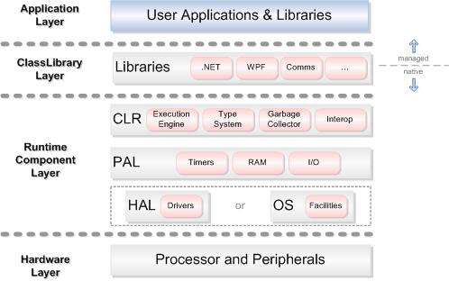
Layered Architecture
Components are organized in layers. Components in one layer generally make procedure calls to the layer below, and are independent of other components in the same layer.

Slide 17
Layered Architecture
Typically, the layers are organized like this:
TOP: User / customer / outward facing
Middleware, standard components
BOTTOM: Hardware

Slide 18
Layered Architecture
Writing a graphics program:
JAVA: drawCircle(centerX, centerY, radius, color);
O/S: SetDCPenColor(color);
Ellipse(cX-rad/2, cy-rad/2, rad*2, rad*2);
OPENGL: glBegin(GL_LINE_LOOP);…
glEnd();
Video Buffer: (255,255,255,255)…(255,0,0,0)…

Slide 19
Layered Architecture
OSI model for networks (Open Systems Interconnection):
Application: HTTP, SMTP, Telnet
Transport: TCP, UDP
Network: IP (v4 or v6), AppleTalk
Physical: DSL, IEEE 802.11, USB, Bluetooth
(showing 4 out of 7 layers)

Slide 20
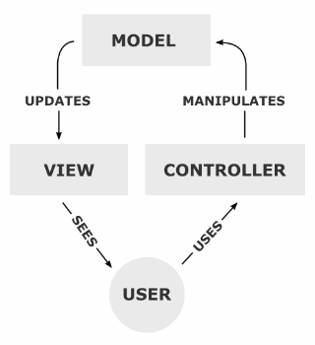
Model View Controller Architecture
View components present information to the user.
Models store information and hold business rules.
Controllers tell views and models to update.

Slide 21
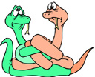
Model View Controller Architecture
Key benefits (from Ian Davis):
Decouples model and view – one model can support multiple views.
Decouples view and controller – can change the way a view responds to user input.

Slide 22
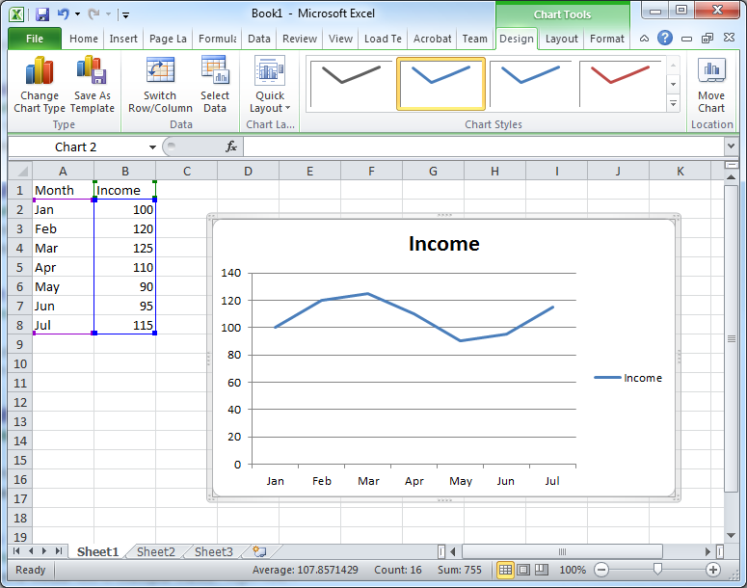
Model View Controller Architecture

Slide 23
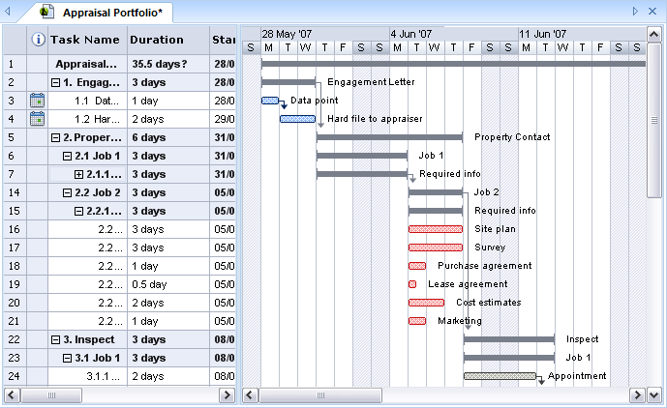
Model View Controller Architecture

Slide 24
Model View Controller Architecture
People interpret “Controller” in different ways.

Slide 25
From the front lines
Hacker news:
https://news.ycombinator.com/item?id=5514284

Slide 26
Two interesting videos about Agile software development
Nordstrom Innovation Lab:
https://www.youtube.com/watch?v=szr0ezLyQHY
A Day in the Life of a Scrum Team:
https://www.youtube.com/watch?v=q1RqhRcPJZ0

