Slide 1
Informatics 43 – May 19, 2016

Slide 2
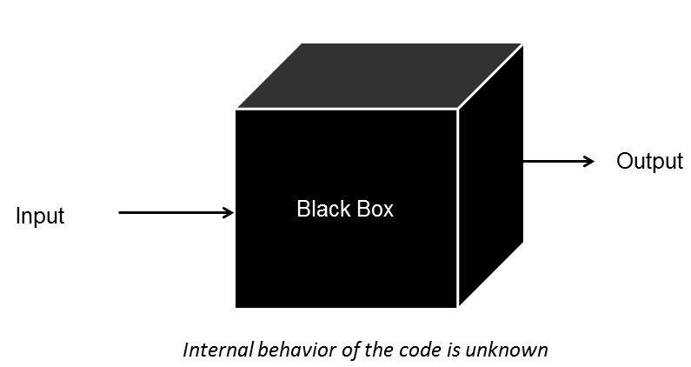
Preliminaries
Midterm 2
Homework 3
Homework 2
Corrections (“several”)
File names and file types
Piazza – what is the input?
Black box

Slide 3
Software Engineering
“The multi-person creation of multi-version programs.”
What does this mean in practice for co-ordinating multiple people?
How do we keep multiple developers for interfering with each other?

Slide 4
Software Engineering
“The multi-person creation of multi-version programs.”
What does this mean in practice for co-ordination?
How do we keep multiple developers for interfering with each other?
Version control software!
(aka revision control and source control)

Slide 5
Version Control Challenges
Software is typically stored in multiple files.
A change (bug fix, new feature) often requires changes to several of these files.
Multiple people are working on the software at the same time.
It is easy for people to “step on each others’ feet”
Two or more people editing a file simultaneously.
Updates need to be synchronized.
People may wait for others to “release” files.

Slide 6
Version Control Solutions
Use software to manage a project’s source files.
git is a popular option and is the basis of homework 3

Slide 7
Software Architecture is...
"The set of principal design decisions about a system."
-Institute for Software Research @ UCI

Slide 8
Software Architecture is...
A collection of software design decisions that work well together.
In building architecture, what are some common architectural styles?

Slide 9
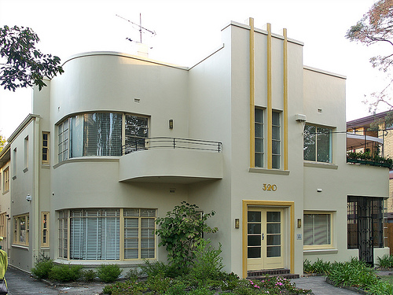
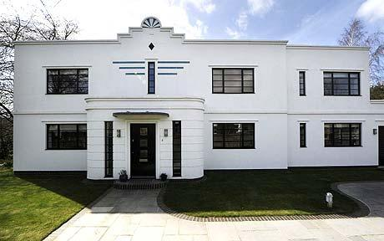
Art Deco
Flat roofs, smooth stucco walls, rounded corners, bold exterior decoration, vertical lines.

Slide 10
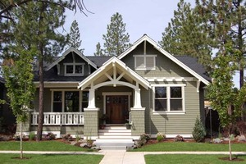
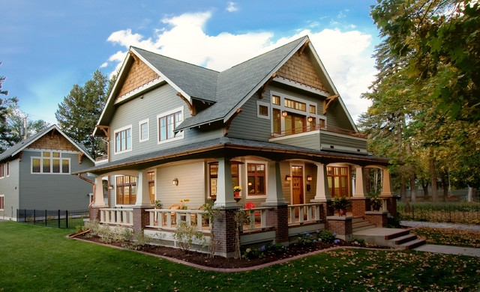
Craftsman
Natural materials (stone and brick), wide front porches, low pitched roofs, eaves, big fireplaces.

Slide 11
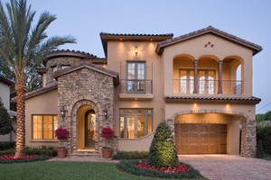
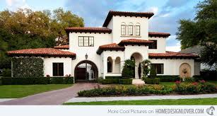
Mediterranean
Red tile roofs, arches, porticos, balconies, heavy wooden doors.

Slide 12
Software Architecture is...
A collection of software design decisions that work well together.
In building architecture, what are some common architectural styles?
What else?
Cuisine (for example: chicken, rice, and vegetables slow cooked in a pot; slices of cold meat and crispy vegetables between two pieces of bread)
Music (for example: strong beat (4/4 time, drum), prominent guitar, simple chord progressions)

Slide 13
Client-server architecture
The client (computer or software) sends requests to a server (computer or software).
Types of servers
Web server (or host) – provides web pages
File/database server – provides files or data
Print server – provides printing capability
and more
One server can work with multiple clients.
The client and server communicate with a defined protocol, typically over a network. They “send messages”.
The client and server need to know very little about each other.
“Two tier”

Slide 14
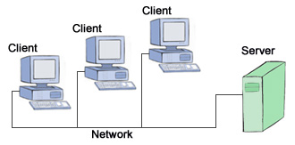
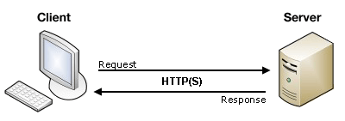
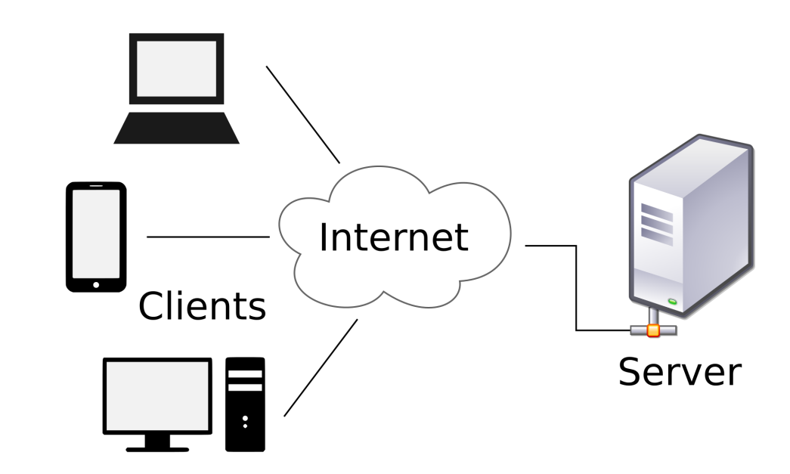
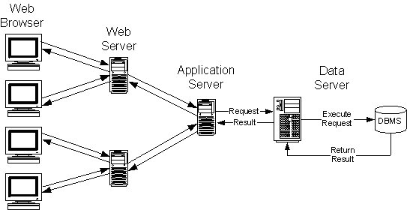
Client-server architecture

Slide 15
n-tier architecture
Multiple nodes (computer or software) are organized in tiers, so that a node acts as a client and sends requests to a server node on the next tier, and acts as a server and processes requests from the previous tier.
A generalization of client-server architecture.
Tier == (more or less) layer.
Often people use 3-tier or n-tier with specific roles for each tier in mind. For example, “Presentation layer, Component layer, Data access layer”.

Slide 16
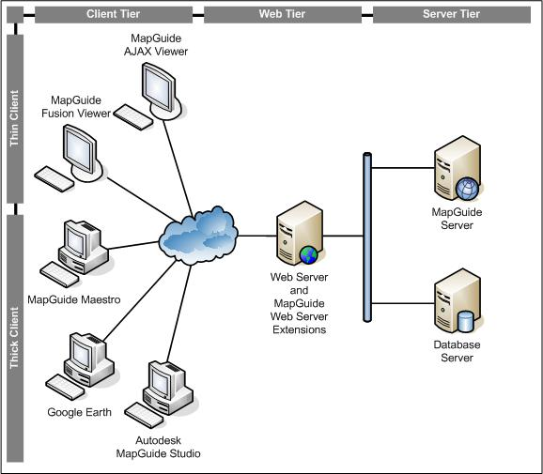
3-tier architecture

Slide 17
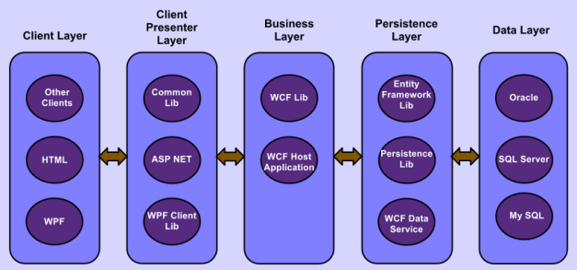
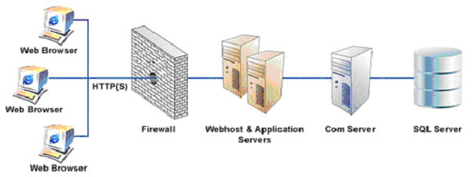
n-tier architecture

Slide 18
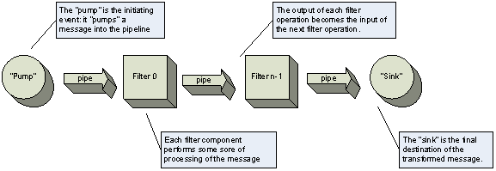
But wait, there’s more
Pipes-and-filters

Slide 19
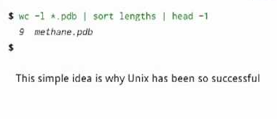
But wait, there’s more
Pipes-and-filters

Slide 20
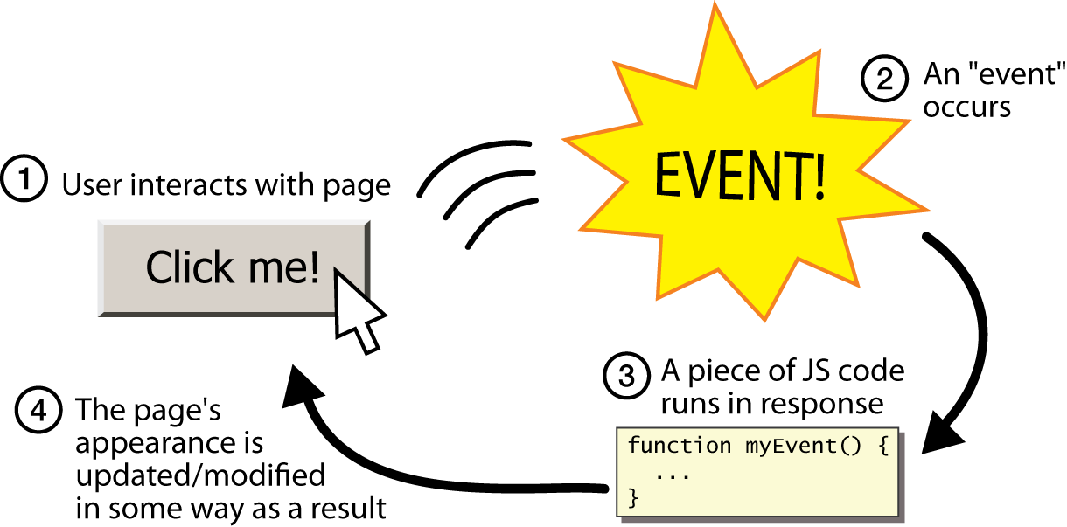
But wait, there’s more
Event driven

Slide 21
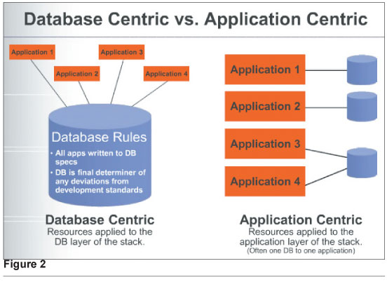
But wait, there’s more
Database-centric

