Slide 1
Informatics 43 – May 12, 2016

Slide 2
Open Source
Source code is freely available and (usually) re-distributable
Examples:
Firefox web browser
Apache HTTP Server
Blender 3D graphics and animation tool
Python programming language
Linux operating system
Benefits of using Open Source Software
Usually free of charge
Security
Can be modified

Slide 3
Open Source
Source code is freely available and (usually) re-distributable
Many contributors working in a distributed manner
Coders
Bug finders
Documenters
Project leadership
Typically volunteers
Heavy reliance on software tools
The web and email
Version control and repositories
Scales up amazingly well
Where do they find the time?
What would Brooks say?

Slide 4
Agile Software Development
A reaction to “rigid” process models.
The “Agile Manifesto”. Agile values…
Individuals and interactions over processes and tools.
Working software over comprehensive documentation.
Customer collaboration over contract negotiation.
Responding to change over following a plan.
What does that mean in practice?

Slide 5
Extreme Programming (XP)
Good practices are worth taking to an extreme level:
Frequent communication between software developers and customers.
Simplicity in code and design.
Small iterations, continuous integration.

Slide 6
Extreme Programming (XP)
Rapid, fine feedback:
Test-driven design (via unit and acceptance tests)
On-site customer
Pair programming
Shared Understanding:
Planning game
Simple Design
System Metaphor
Collective Code Ownership
Coding Conventions
Continuous process:
Continuous integration
Merciless refactoring
Small, frequent releases
Developer Welfare:
Forty-hour week
From Glenn Vanderburg, Delphi Consultants

Slide 7
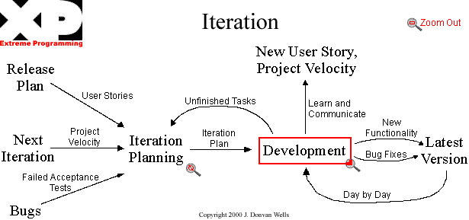
Extreme Programming (XP)

Slide 8
Extreme Programming (XP)
(Some of) The Rules of Extreme Programming
Planning: Make frequent small releases.
Managing: Give the team a dedicated open work space.
Designing: Refactor whenever and wherever possible.
Coding: All production code is pair programmed.
Testing: All code must have unit tests.
Kids, collect the entire set at
http://www.extremeprogramming.org/rules.html

Slide 9
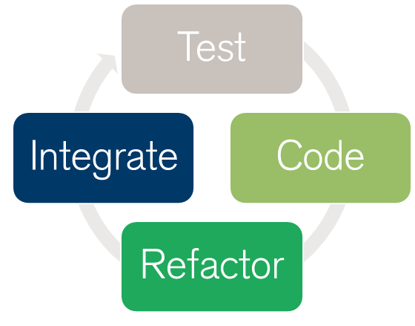
Refactoring

Slide 10
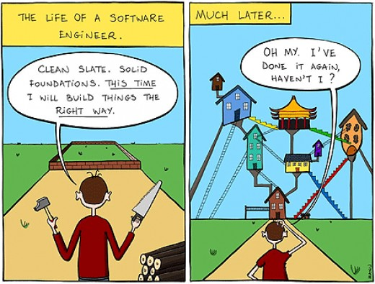
Refactoring

Slide 11
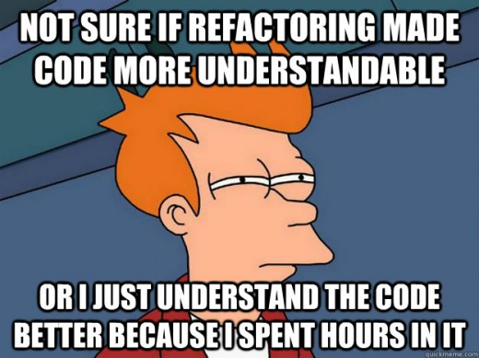
Refactoring

Slide 12
Refactoring

Slide 13
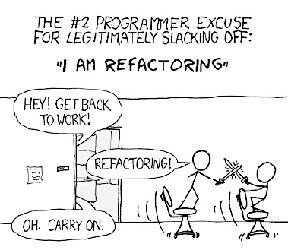
Refactoring

Slide 14
Refactoring

Slide 15
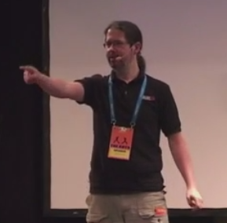
Putting it all together
In 7:26, from J. B. Rainsberger
http://blog.thecodewhisperer.com/2013/11/11/the-eternal-struggle-between-business-and-programmers/

