Slide 1
Informatics 43 – May 10, 2016

Slide 2
Unity workshop
Unity is a popular game engine
Hack is a fun and intense experience
Hack is excited to present:
Event: Week #8 Unity Workshop
When: Wednesday, May 18 6pm-10pm
Where: DBH 6011
RSVP: http://www.tinyurl.com/UnityWSHack
Description:
Hello Hackers! Have you ever wanted to build your own game in VR? Do you want to see C# in action? Then come to Unity Workshop where Unity will be providing us with VR tech for you to mess around with!
SCHEDULE:
6-7 PM -- Overview Unity 5.4, Adam & VR
7-10 PM -- Hands on Creating - Multiplayer Games
RVSP now to guarantee yourself food at the event!
THINGS THAT YOU SHOULD BRING: A laptop with Unity downloaded (https://unity3d.com/get-unity/download)
Sponsored and hosted by: Unity

Slide 3
Restatement of Goals for Testing
Want to verify software’s correctness →
Need to test →
Need to decide on test cases →
No set of test cases is sufficient
What is a systematic approach to the selection of test cases that will lead to accurate, thorough, repeatable identification of bugs?

Slide 4
The Testing Process Model
Decide what to test.
Select a test case input.
Determine the expected output E.
Run the system with the test case input.
Capture the actual output A.
Compare E and A.
Different? Inform programmer.
Loop back to 1 or 2, if time permits.

Slide 5
Back to Black box test case selection
Equivalence Class Partitioning – a systematic approach.
Identify the set of all possible inputs (to what is being tested).
Identify a basis for subdividing the set of inputs.
specifications, size, order, structure, your smarts
think twice about defining a basis in terms of the system output
Use this basis for dividing the set of all possible inputs into subsets (domain into subdomains).
From each subset/subdomain, select a representative instance to be a test case input.

Slide 6
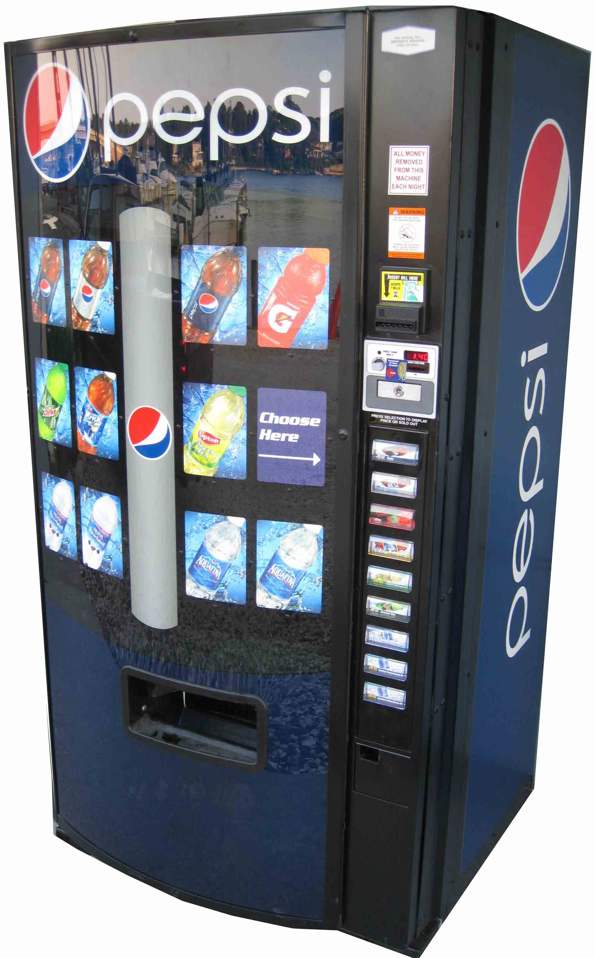

Slide 7
Equivalence Class Partitioning and the soda machine
Identify the set of all possible inputs.
Identify a basis for subdividing the set of inputs.
Use this basis for dividing the set of all possible inputs into subsets (domain into subdomains).
From each subset/subdomain, select a representative.

Slide 8
Another example for testing…
A software function called “Password Strength”.
PasswordStrength evaluates a potential password on a scale of 1 to 10. A strong password (evaluating to a higher number) has a combination of digits, symbols, and upper and lower case letters, and also is very different than the same user’s last three passwords. A weak password is shorter, similar to the last three passwords, and has less variety of characters.

Slide 9
Equivalence Class Partitioning and PasswordStrength
Identify the set of all possible inputs.
Identify a basis for subdividing the set of inputs.
Use this basis for dividing the set of all possible inputs into subsets (domain into subdomains).
From each subset/subdomain, select a representative.

Slide 10
The Mythical Man-Month
Causes for scheduling disasters:
We expect that all will go well.
We confuse effort with progress, and think that people and months are interchangeable.
Managers are often insufficiently stubborn.
Schedule progress is poorly monitored.
When schedule slippage is recognized, more people are added.
Brooks’s Law:
Adding manpower to a late software project makes it later.

Slide 11
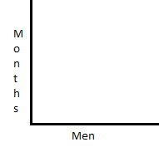
Unpartitionable task
“the application of more effort has no effect on the schedule”

Slide 12
Perfectly
partitionable task
“true of reaping wheat or picking cotton”

Slide 13
Perfectly
partitionable task
“true of reaping wheat or picking cotton”
People * months = a constant

Slide 14
Partitionable task requiring communication
“The effort of communication must be added to the amount of work to be done.”

Slide 15
Task with complex interrelationships
“The effort increases as n(n-1)/2. The added effort of communication may fully counteract the [benefits of the] division of the original task [among multiple workers].”

Slide 16
“No parts of the schedule are so thoroughly affected by sequential constraints as component debugging and system test.”
What is component debugging?
What is system test?
Why are they affected by sequential constraints?

Slide 17
Your job:
Go back to the “Regenerative Schedule Disaster” section of The Mythical Man-Month, and read it through carefully, making sure you understand figures 2.5 through 2.8.
This exercise will pay off in your career.

Slide 18
Modularization
A fundamental aspect of software design is dividing the whole into modules.
Ideally, everything within a module interacts strongly: “High cohesion”
Ideally, separate modules interact as little as possible: “Low coupling”
Good decomposition into modules serves many purposes.
Easier to understand each module by itself.
Easier to see and understand the big picture.

Slide 19
Modularization
A fundamental aspect of software design is dividing the whole into modules.
Ideally, everything within a module interacts strongly: “High cohesion”
Ideally, separate modules interact as little as possible: “Low coupling”
Good decomposition into modules serves many purposes.
Easier to understand each module by itself.
The module coheres and is (relatively) independent.
Easier to see and understand the big picture.

Slide 20
Modularization
A fundamental aspect of software design is dividing the whole into modules.
Ideally, everything within a module interacts strongly: “High cohesion”
Ideally, separate modules interact as little as possible: “Low coupling”
Good decomposition into modules serves many purposes.
Easier to understand each module by itself.
The module coheres and is (relatively) independent.
Easier to see and understand the big picture.
The “insides” of each module can be ignored.

Slide 21
Modularization Examples
A photo library.
Throwing a party.
Air traffic control system.

Slide 22
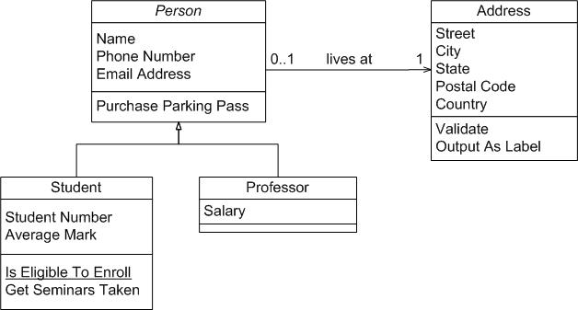
UML Class Diagram

