Slide 1
Informatics 43 – May 5, 2016

Slide 2
Restatement of Goals for Testing
Want to verify software’s correctness →
Need to test →
Need to decide on test cases →
No set of test cases is sufficient
What is a systematic approach to the selection of test cases that will lead to accurate, thorough, repeatable identification of bugs?

Slide 3
The Testing Process Model
Decide what to test.
Select a test case input.
Determine the expected output E.
Run the system with the test case input.
Capture the actual output A.
Compare E and A.
Different? Inform programmer.
Loop back to 1 or 2, if time permits.

Slide 4
Back to Black box test case selection
Equivalence Class Partitioning – a systematic approach.
Identify the set of all possible inputs (to what is being tested).
Identify a basis for subdividing the set of inputs.
size, order, structure
correctness
stated requirements
your smarts
Use this basis for dividing the set of all possible inputs into subsets (domain into subdomains).
From each subset/subdomain, select a representative.

Slide 5
Testing Matrix
Basis _______________________
Equivalence Class Partitions
Notes from execution
Expected Output
Input (Specific values)

Slide 6
Testing Matrix
Quiz Average - Basis Length of list
Equivalence Class Partitions
Notes from execution
Expected Output
Input (Specific values)
0 [] 0.0
1 [87.3] 87.3
2 – 4 [90, 95, 85] 92.5
5 and up [80, 81, 82, 83, 84, 85, 86, 87, 86.0
88, 89, 90, 91]

Slide 7
Testing Matrix
Quiz Average - Basis Position of minimum value
Equivalence Class Partitions
Notes from execution
ExpectedOutput
Input (Specific values)
First element [80, 87, 88, 89] 88.0
Middle element [87, 88, 80, 89] 88.0
[99, 98, 0, 97, 96] 97.5
Last element [87, 88, 89, 80] 88.0

Slide 8
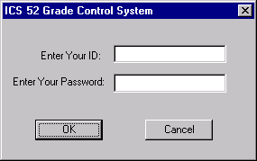
Security Dialog Example

Slide 9
Testing Matrix
Basis Security Dialog #1 – choice of button
Notes from execution
Equivalence Partitions
ExpectedOutput
Input (Specific values)
Ok Button Press OK see Security
Dialog #2
Cancel button Enter ID “R09”, press Cancel Text boxes are
cleared, dialog
remains
Don’t enter ID, press Cancel Same.
X button Enter ID “R09”, press X Text boxes are
cleared, dialog
remains

Slide 10
Testing Matrix
Basis Security Dialog #2 – OK button pressed, validity of input
Notes from execution
Equivalence Partitions
Expected Output
Input (Specific values)
Valid ID, TEST1, 77775555 Proceed to
Matching PW Main screen
Valid ID, TEST1, 7777555 Audible beep,
Wrong PW dialog remains.
Invalid ID, TES1, 77775555 Same

Slide 11
The Testing Process Model
Decide what to test.
Select a test case input.
Determine the expected output E.
Run the system with the test case input.
Capture the actual output A.
Compare E and A.
Different? Inform programmer.
Loop back to 1 or 2, if time permits.
Where does this come from?

Slide 12
Automated Testing for League of Legends
Run 100,000 test cases a day.
100 code and content changes a day “checked in to source control”
Continuous integration: test cases are run when new code is checked in
“Test farm”: a collection of computers dedicated to running tests
Tests can run locally (on developer’s computer) or on the test farm.

Slide 13
Automated Testing for League of Legends
“bug ticket”: a record of the bug (the failure that was recorded)
“flaky or unreliable tests”. To be trusted
Code reviewed (manual inspection)
Enters “staging” status
Must demonstrate stability for a week
Promoted to Blocker or Core

Slide 14
Automated Testing for League of Legends
“Test Set”: a group of tests that are run together
“Tests”: a set of similar test cases
“Test cases”: single units of expected functionality within a test

Slide 15
Automated Testing for League of Legends
From the comments:
Q. Shouldn't you override the 'deal damage to target' function that is called when an auto-attack lands and only check the values going into there?
A. That's the difference between white-box and black-box testing. This is a black-box test that doesn't assume anything about how damage gets dealt, just verifying that the correct amount of damage did get dealt from the attack+ability combo.

Slide 16
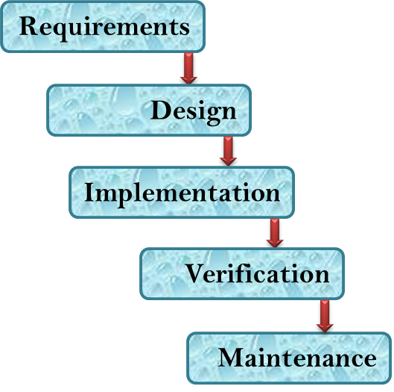
The Design Phase of Software Development

Slide 17
The Design Phase of Software Development
Something usually needs to be done after the user’s requirements are specified and before coding starts, especially on larger tasks.
Modularize the task so that multiple people can work on it.
Define modules and their interfaces.
Make system-wide decisions.
Architecture, languages, libraries, platforms.
Develop the specifications in more detail.
More “how”; consideration of trade-offs.

Slide 18
Software Development Languages
Different languages are used at different stages:
Requirements Design Coding Testing
English Java, Python testing
matrix

Slide 19
Software Development Languages
Different languages are used at different stages:
Requirements Design Coding Testing
English Java, Python testing
matrix
Languages have two purposes:
To communicate with other people.
To clarify one’s own thinking and ideas.

Slide 20
Deep thoughts about diagrams
It’s important to think of a diagram as being a statement in a language that has a syntax.
A diagram is not a picture.
A diagram has to be interpreted.
A
B

Slide 21
What might this mean?
A
B
A happens before B.

Slide 22
Unified Modeling Language (UML)
A set of a dozen or so visual languages for expressing various aspects of software development.

Slide 23
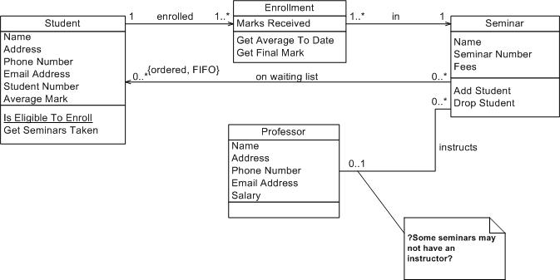
UML Class Diagram

Slide 24
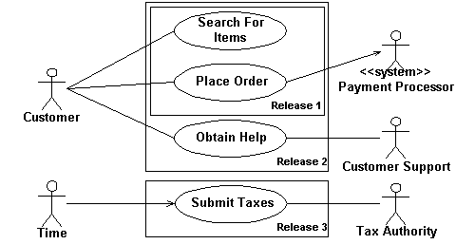
UML Use Case Diagram

Slide 25
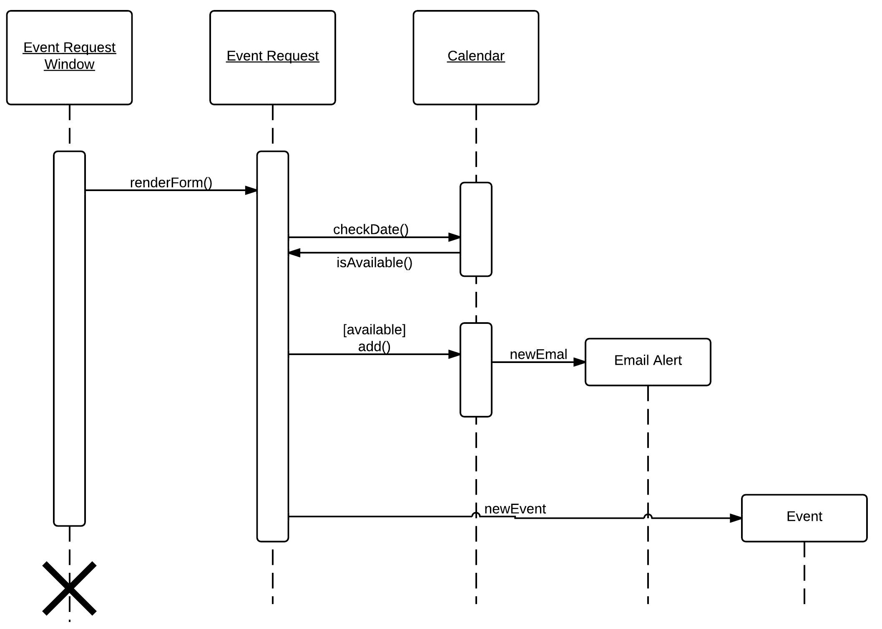
UML Sequence Diagram

Slide 26
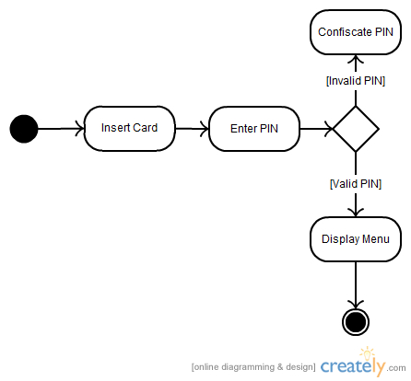
UML Activity Diagram

Slide 27
The UML Class Diagram helps in the decomposition of a system into sub-modules known as classes.
Some “object oriented” programming languages have “class” as part of the language’s syntax and design, but UML Class Diagrams can be created and used without reference to programming language classes.
Some following slides from
www.cs.drexel.edu/~spiros/teaching/CS575/slides/uml.ppt

Slide 28
Classes
A class is a description of a set of
objects that share the same attributes,
operations, relationships, and semantics.
Graphically, a class is rendered as a
rectangle, usually including its name,
attributes, and operations in separate,
designated compartments.
ClassName
attributes
operations

Slide 29
Class Names
ClassName
The name of the class is the only required tag in the graphical representation of a class. It always appears in the top-most compartment.
attributes
operations

Slide 30
Class Attributes
Person
name : String
address : Address
birthdate : Date
ssn : Id
An attribute is a named property of a
class that describes the object being modeled. In the class diagram, attributes appear in the second compartment just below the name-compartment.

Slide 31
Class Attributes (Cont’d)
Person
name : String
address : Address
birthdate : Date
ssn : Id
Attributes are usually listed in the form:
attributeName : Type

Slide 32
Class Operations
Person
name : String
address : Address
birthdate : Date
ssn : Id
eat
sleep
work
play
Operations describe the class behavior
and appear in the third compartment.

Slide 33
Depicting Classes
When drawing a class, you needn’t show attributes and operations in every diagram.
Person
Person
Person
name : String
birthdate : Date
ssn : Id
Person
name
address
birthdate
eat()
sleep()
work()
play()
Person
eat
play

Slide 34
Association Relationships
If two classes in a model need to communicate with each other, there must be link between them.
An association line denotes that link.
Student
Instructor

Slide 35
Association Relationships (Cont’d)
We can constrain the association relationship by defining the navigability of the association.
Here, a Router object requests services from a DNS object by sending messages to (invoking the operations of) the server.
The direction of the association arrow indicates that the server has no knowledge of the Router.
Router
DomainNameServer

