Slide 1
Informatics 43 – April 26, 2016

Slide 2
Announcements
Apply to be an AppJam+ Summer Mentor!
AppJam+ Partners with local universities and Colleges to recruit mentors for the program. Mentors are a very critical part of the program and help empower middle school students and aid in exposing them to opportunities in STEM through the program. AppJam+ looks great on a resume and mentors receive a stipend. Apply at: appjamplus.com/mentors Application deadline is April 29th at midnight. For more information please visit our site appjamplus.com or email us atappjamplus@gmail.com

Slide 3
Announcements
MAISS Mentor Recruitment – Management Information Student Society
Applications Due: Week 7 (Friday, May 13)
Interviews: Week 8 (May 16-20)
Decisions: Week 8 (May 21)​
If you are interested in making a positive impact on another student’s college experience as well as the UCI business and technology community, the MAISS mentorship program is for you! The mentorship program fosters lasting relationships between mentees and their respective mentors. If you are interested in becoming a mentor, apply at http://bit.ly/MAISS-Mentor-Recruitment. For more information about MAISS, visit www.maissuci.com.​​

Slide 4
Fun with Models
Fashion
Student
Model = Ideal

Slide 5
Fun with Models
Fashion
Student
Model = Ideal

Slide 6
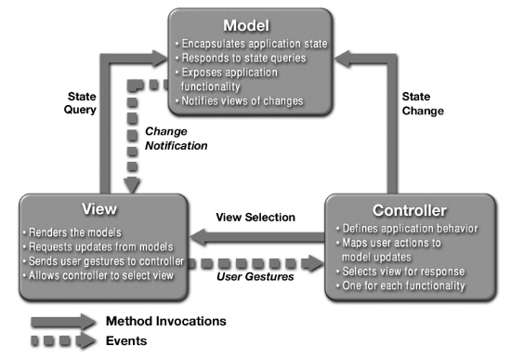
Fun with Models
Model = Simplified Representation
Software Process Model
Waterfall
Prototype
Spiral
Architecture Model
Layered
Client Server
Model View Controller

Slide 7
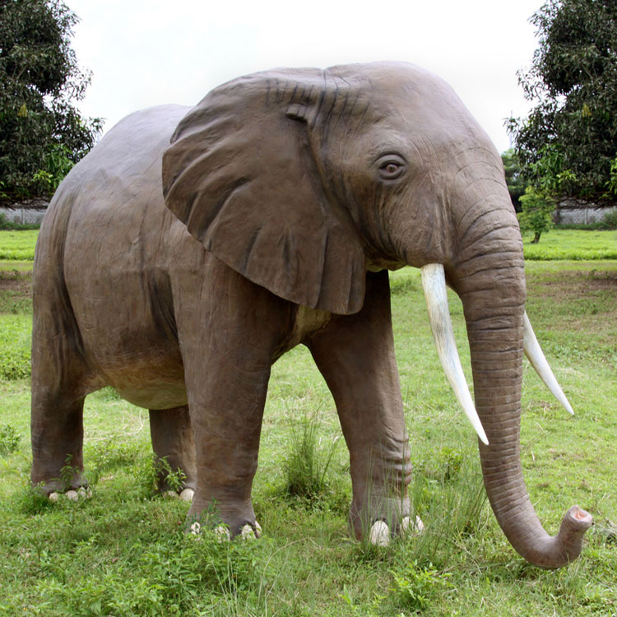
Fun with Models
Model = Simplified Representation
public class Elephant {
int weight; // in kg
String name;
Species species;
public void forage() {
. . . .
}
}

Slide 8
How to choose a Software Process Model?
A Software Process Model can be thought of
“prescriptively” – providing rules to follow in the future
or
“descriptively” – serving to describe or characterize
what has happened in the past

Slide 9
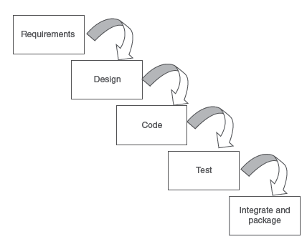
The Waterfall Software Process Model

Slide 10
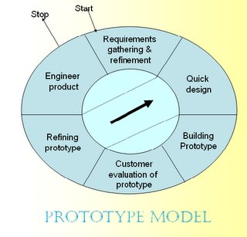
The Prototyping Software Process Model

Slide 11
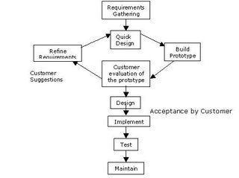
The Prototyping Software Process Model

Slide 12
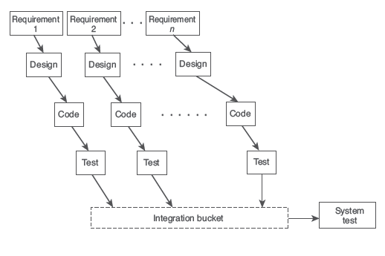
Incremental Software Process Model

Slide 13
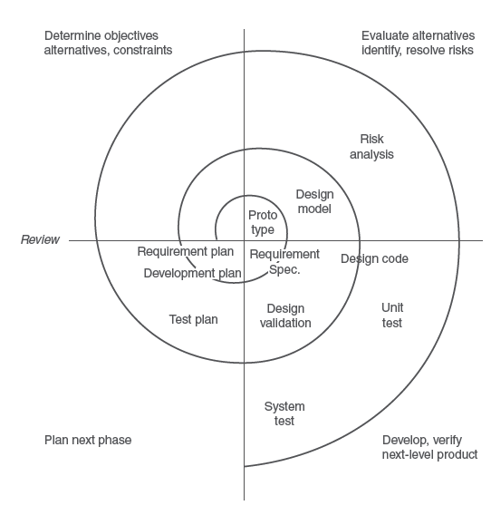
Spiral Model

Slide 14
Spiral Model
Risk-driven, focus on considering alternatives
Each loop through the cycle:
Identify a high-risk sub-problem or aspect
Resolve the risk (as far as possible)
A software project goes through the loop many times
Every person on the development team does not have to be at the same stage of the loop

Slide 15
Software Risks
Some of Boehm’s Top 10
Personnel shortfalls
Unrealistic schedules and budgets
Developing the wrong software functions
Continuing stream of software changes
Shortfalls in externally furnished components
Shortfalls in externally performed tasks

Slide 16
Agile Software Development
We will come back to this topic later in the quarter…
Notes:
See 2014 4-2

Slide 17
Quality Assurance
What software qualities do we want to assure?
Correctness

Slide 18
Quality Assurance
What software qualities do we want to assure?
Correctness
How?
Testing
Inspection and review the source code
Proofs, formal methods
Static analysis (a program inspects the source code)

Slide 19
Testing Challenges
Edsger Dijkstra: “Testing can show the presence of bugs, but not their absence.”
True?
Why?

Slide 20
Testing Challenges
Edsger Dijkstra: “Testing can show the presence of bugs, but not their absence.”
True! Because…
Software systems are discrete, not continuous.
Too many input-output pairs (test-cases) to exhaustively verify, so we must take a small sample.
Example: multiplier, inputs two integers, outputs one integer

Slide 21
Testing Challenges
Let’s be practical.
Testing can only select a very small set of inputs.
Our goal should be to choose the best ones.
What are the best 5 test cases for a multiplier?
(In other words: what 5 test cases, if they don’t reveal any bugs, will give you the most confidence that the multiplier is working correctly?)

Slide 22
Best set of test cases
What are the best 5 test cases for a multiplier?
(Give you the most confidence that the multiplier is working correctly?)
WEAK | STRONG
3 x 4 = 12
4 x 3 = 12
5 x 7 = 35
6 x 3 = 18
10 x 10 = 100

Slide 23
Result of running test cases
-- 100%
Confidence in module being tested
Sweet spot?
Number of test cases with correct outputs

Slide 24
The landscape of “bugs”
Error (in programmer’s mind)
Fault or defect (in code)
Failure (in execution or output)

Slide 25
The landscape of “bugs”
Error (in programmer’s mind)
Fault or defect (in code)
Failure (in execution or output)

