Slide 1
Informatics 43 – April 19, 2016

Slide 2
Things to know
Midterm on Thursday, April 21
Closed book, closed notes, bring pen/pencil
Questions available on web page
Special seating plan
Lectures are recorded with UCI Replay
No discussions this Friday
Readings for next Tuesday

Slide 3
What is Software Engineering?
Informatics 43:
The process of constructing software.
Phases of development other than programming.
Principles and qualities of enduring value.
Also of interest:
Managing software development teams.
Making money – business models.
Software’s impact on users, organizations, and society.
Straight outta Week 1

Slide 4
What is Software Engineering?
Informatics 43:
The process of constructing software.
Phases of development other than programming.
Principles and qualities of enduring value.
Also of interest:
Managing software development teams.
Making money – business models.
Software’s impact on users, organizations, and society.
Straight outta Week 1

Slide 5
The Process of Constructing Software
Software Process Models
The Software Lifecycle

Slide 6
The Process of Constructing Software
The Process of Dining at a Restaurant

Slide 7
The Process of Constructing Software
The Process of Dining at a Restaurant
Activities (in alphabetical order):
Eat
Pay
Select
Serve

Slide 8
Eat, Pay, Select, Serve
Restaurant | Type of Restaurant | Order of Activities

Slide 9
We just modeled
The Process of Dining at a Restaurant
Was anything left out?
Is the model too simple?
Is the model useful?

Slide 10
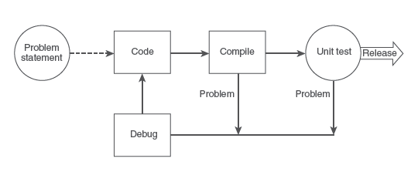
A Programming-centric Software Process Model
Application domain problem
Programming problem
Figure 4.1 A simple process

Slide 11
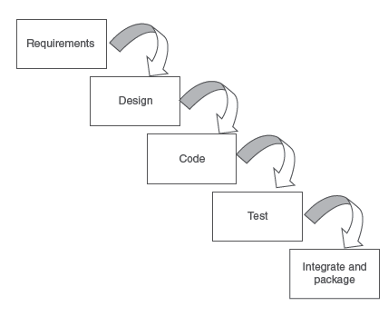
The Waterfall Software Process Model
Figure 4.2 A waterfall model

Slide 12
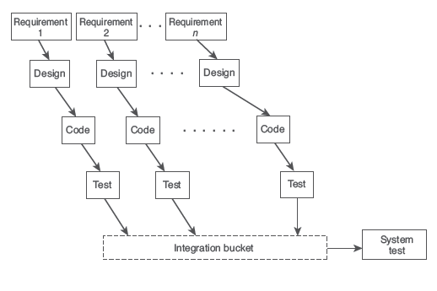
Incremental Software Process Model

Slide 13
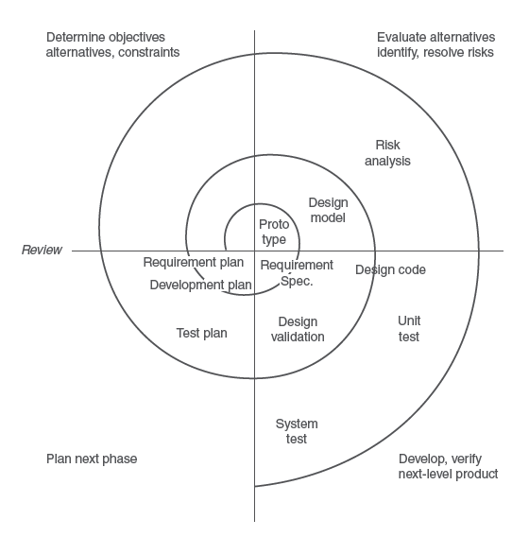
Spiral Model

Slide 14
The Mythical Man-Month, Frederick Brooks
Causes for scheduling disasters:
We expect that all will go well.
We confuse effort with progress, and think that people and months are interchangeable.
Managers are often insufficiently stubborn.
Schedule progress is poorly monitored.
When schedule slippage is recognized, more people are added.
Brooks’s Law:
Adding manpower to a late software project makes it later.

Slide 15
The Mythical Man-Month
Why is the man-month as a unit for measuring the size of a job a dangerous and deceptive myth?

