Slide 1
Informatics 43 – April 14, 2016

Slide 2
Homework 1
When are the TAs’ and Readers’ office hours for homework 1?
Ashwin Achar – Friday, 1:00pm, DBH 5th floor lobby and Monday, 2:00-5:00 in DBH 5th floor lobby
Shibani Konchady – Thursday, 2:00pm, DBH 5231 (CRADL Lab)
Tanooj Parekh – Friday, 2:00pm, DBH 4th floor lobby
Kishore Narendran – Monday, 11:00am, DBH 5th floor lobby

Slide 3
Homework 1
What is the purpose and goal of each section in the document?
Two audiences: non-technical users and technical developers.
Clear, business-like English so that the focus is on the content and ideas.

Slide 4
Homework 1
What is the purpose and goal of each section in the document?
Introduction: someone who reads only the Introduction should have a clear and accurate understanding of the entire document.
Purpose and objectives
Software product overview – main features
Business and financial objectives

Slide 5
Homework 1
What is the purpose and goal of each section in the document?
Description of the Problem
– whose problem?
Why the software is needed (from customer’s perspective)
Open issues and questions – concerns not yet addressed

Slide 6
Homework 1
What is the purpose and goal of each section in the document?
Use Cases
Keep each one simple and concrete
Avoid programmer jargon
Focus on “real world” uses, not computer system uses
The main goal is to convey the scope of the proposed software

Slide 7
Homework 1
What is the purpose and goal of each section in the document?
Description of the Software Solution
Focus on features and functionality
Avoid implementation decisions

Slide 8
Types of Requirements
Functional Requirements – input-output mapping
Nonfunctional Requirement – qualities
Design Constraints – external factors

Slide 9
What vs. How
An example of “separation of concerns” – in the requirements process, don’t design and don’t program.
What the customer needs
What problems will be addressed
What the system should accomplish

Slide 10
What vs. How - example
Suppose your client says, “With our current system, people are always complaining that the words on the screen are too hard to read. We do have a lot of older and low-vision users. Can you fix that?”

Slide 11
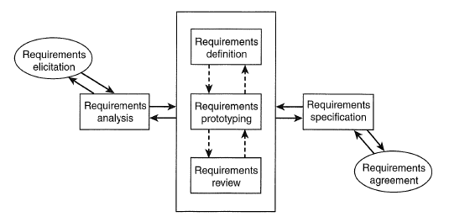
A requirements process

Slide 12
A requirements process

Slide 13
Prototyping for requirements
A prototype is a first or early version.
A prototype is a model.
Software is invisible. (Brooks)
A prototype helps people see (understand) the requirements.
What should be prototyped?
What happens to the prototype? – should it be thrown away?

Slide 14
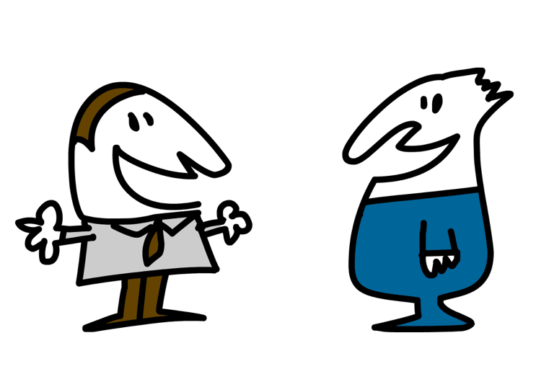
Let’s talk about the midterm next week.

Slide 15
How to study in Informatics 43
Close reading of the textbook is required – even if it is boring.
An example from p. 105:

Slide 16
How to study in Informatics 43
Once the [requirements engineering] plan is drawn, it must be reviewed and agreed upon by all parties involved. This agreement and commitment to the plan is extremely important because requirements are not just an imagination of the software designer or developer. The users and customers must be involved because requirements represent their needs and desires.

Slide 17
How to study in Informatics 43
Management must also be involved because resources are required to perform the activities. The management from both the users’ side and the software development side must be willing to commit the resources. Finally, the schedule for the requirements engineering activities must be reviewed and agreed upon by all participants.

Slide 18
How to study in Informatics 43
There have been situations where prototype development, reviews, and changes to the user interface requirements alone have taken such a significant portion of the software development resources and schedule that the project was doomed for a later schedule crunch and cost over-run.

