Slide 1
Informatics 43 – April 5, 2016

Slide 2
Announcements
Discussions did meet on Friday, April 1.
Oh no, I missed discussion!?
Discussion again on Friday, April 8
Homework 1
Thursday: interview with our client
No group note-taking
Audio may be posted online
Autism App Jam http://2016.autismappjam.com

Slide 3
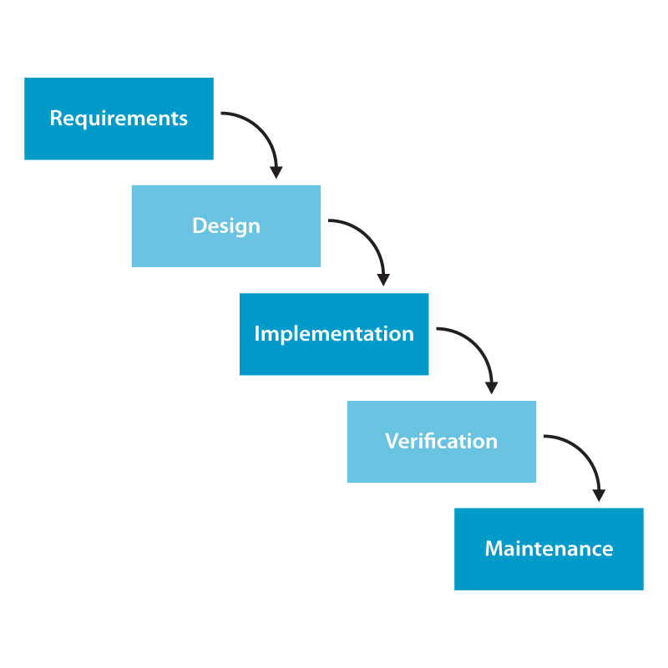
The Waterfall Model process of constructing software.

Slide 4
Requirements Engineering
Elicitation
Specification (& Documentation)
Prototyping
Analysis
Review and validation
Agreement and acceptance

Slide 5
Requirements Specification
Contract – two audiences
Includes
Functional requirements - capabilities
Non-functional requirements – constraints, “ilities”
Design constraints
Desired qualities
Correct…

Slide 6
Requirements Specification
Desired qualities
Correct…

Slide 7
Which category employs the most computer programmers in the U. S.?
In-house staff writing systems for internal use.
Games, apps, productivity software.
Consulting companies / contract programming.
Open source projects.
Creators of viruses and other malware.

Slide 8
Developers and users –
What is their impact on the requirements process?
Varying relationships between the software team and the software users –
Consumer software (productivity, games)
In-house development team
Contract developers
Free-to-play

Slide 9
Source: Enterprise Programmer blog, http://enterpriseprogrammer.com/2012/06/22/how-we-develop-software-methodology-segment/

