Slide 1
Informatics 43 – March 31, 2016

Slide 2
What is Software Engineering?
Software –
Engineering -

Slide 3
What is Software Engineering?
Software –
Engineering -
Code
Documentation, user manuals
Designs, specifications
Test cases
Plans and schedules

Slide 4
What is Software Engineering?
Software –
Engineering -
Code
Documentation, user manuals
Designs, specifications
Test cases
Plans and schedules
Skill and knowledge
Application of scientific principles
Trade-offs, cost / benefit analysis

Slide 5
From the textbook
What is Software Engineering?
The establishment and use of sound engineering principles (methods) in order to obtain economically software that is reliable and works on real machines.
The application of a systematic, disciplined, quantifiable approach to the development, operation, and maintenance of software.

Slide 6
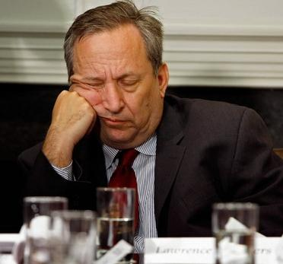

Slide 7
What is Software Engineering?
David Parnas and Brian Randell:
“The multi-person development of
multi-version programs.”

Slide 8
What is Software Engineering?
An important component of your future career.
Developer of software
Co-worker with software developers
Manager of software developers
User of developed software
Payer for developed software

Slide 9
What is Software Engineering?
Informatics 43:
The process of constructing software.
Phases of development other than programming.
Principles and qualities of enduring value.

Slide 10
What is Software Engineering?
Informatics 43:
The process of constructing software.
Phases of development other than programming.
Principles and qualities of enduring value.
Also of (lesser) interest (in this course):
Managing & scheduling software development teams.
Making money – business models.
Software’s impact on users, organizations, and society.

Slide 11
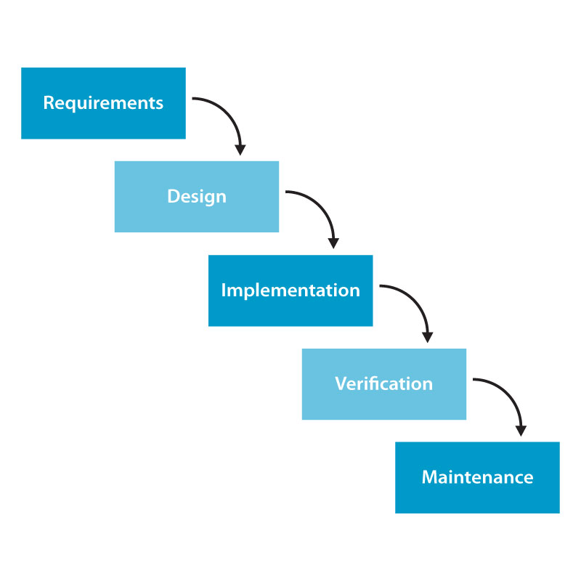
What is Software Engineering?
The process of constructing software.

Slide 12
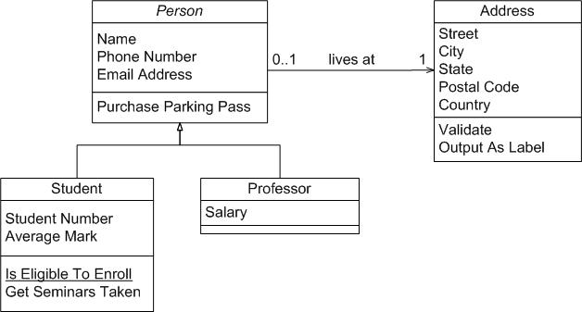
What is Software Engineering?
Phases of development other than programming.
Design:

Slide 13
What is Software Engineering?
Principles and qualities of enduring value.
Correctness!
MODULARITY

Slide 15
No Silver Bullet – Essence and Accident in Software Engineering,
by Frederick Brooks
A software project can become a monster of missed schedules, blown budgets, and flawed products.

Slide 16
No Silver Bullet
The difficulties of software…
Essence: “difficulties inherent in the nature of software”
Accident: “difficulties that today attend its production but are not inherent” – for example, the representation of the essence in a programming language

Slide 17
No Silver Bullet – the essence of a software entity:
“a construct of interlocking concepts: data structures and classes, algorithms, function calls.”
“the hard part of building software is the specification, design, and testing of the conceptual construct – not the programming and testing of the code.”

Slide 18
Inherent properties of the essence – Complexity
Software entities are complex.
“No two parts are alike.”
Nonlinear increase of complexity with size
→ difficulty of communication among team members
→ unreliability
→ hard to use
→ difficulty of extending
→ security trapdoors

Slide 19
Inherent properties of the essence– Conformity
Software must conform to human institutions and systems.
No way to “simplify out” this complexity by redesigning the software alone.

Slide 20
Inherent properties of the essence– Changeability
“All successful software gets changed.”
Pressures for extended function.
Software can be changed more easily.
Successful software survives beyond the life of the hardware for which it was written.

Slide 21
Inherent properties of the essence– Invisibility
Software is unvisualizable.
“The reality of software is not inherently embedded in space.”
Hinders both understanding and communication among minds.

Slide 22
No Silver Bullet – Past Breakthroughs
Most fruitful steps (as of mid 1980s)
High-level languages.
Time-sharing.
Unified programming environments.

Slide 23
No Silver Bullet – Hopes for the Silver
Ada and other high level languages.
Object-oriented programming.
Artificial intelligence.
Expert systems.
“Automatic” programming.
Graphical programming.
Program verification.
Environments and tools.
Workstations.

Slide 24
No Silver Bullet – Promising Attacks
Buy versus build.
Requirements refinement and rapid prototyping.
Incremental development—grow, not build software.
Great designers. “The central question of how to improve the software art centers, as always, on people.”

Slide 25
To do:
Readings for discussion tomorrow
Think about the “root” causes of software project failures…
“Creeping user requirements”
What Brooks says
What Ortiz says Castro says

Slide 26
Feature Creep

