Slide 1
Informatics 43 – March 29, 2016

Slide 2
Course Staff
Prof. Dan Frost
TA Tanooj Parekh (10:00 and 3:00 discussions)
TA Ashwin Achar (11:00 and 12:00 discussions)
TA Shibani Konchady (1:00 and 2:00 discussions)
Reader Soumya Mishra
Reader Kishore Narendran

Slide 3
What is Software Engineering?

Slide 4
What is Software Engineering?
Software –
Engineering -

Slide 5
What is Software Engineering?
Software –
Engineering -
Code
Documentation, user manuals
Designs, specifications
Test cases
Plans and schedules

Slide 6
What is Software Engineering?
Software –
Engineering -
Code
Documentation, user manuals
Designs, specifications
Test cases
Plans and schedules
Skill and knowledge
Application of scientific principles
Trade-offs, cost / benefit analysis

Slide 7
From the textbook
What is Software Engineering?
The establishment and use of sound engineering principles (methods) in order to obtain economically software that is reliable and works on real machines.
The application of a systematic, disciplined, quantifiable approach to the development, operation, and maintenance of software.

Slide 8
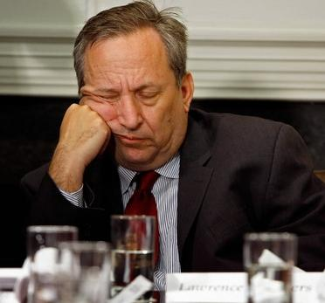
From the textbook
What is Software Engineering?
The establishment and use of sound engineering principles (methods) in order to obtain economically software that is reliable and works on real machines.
The application of a systematic, disciplined, quantifiable approach to the development, operation, and maintenance of software.

Slide 9
What is Software Engineering?
David Parnas and Brian Randell:
“The multi-person development of
multi-version programs.”

Slide 10
What is Software Engineering?
An important component of your future career.
Developer of software
Co-worker with software developers
Manager of software developers
User of developed software
Payer for developed software

Slide 11
What is Software Engineering?
The foundational principles and skills upon which all large scale software development relies.
Recognizing the role and importance of human, organizational, and cultural factors is paramount for successful software engineering.

Slide 12
What is Software Engineering?
Informatics 43:
The process of constructing software.
Phases of development other than programming.
Developing specifications
Quality assurance
Principles and qualities of enduring value.

Slide 13
What is Software Engineering?

Slide 14
AN
What is Software Engineering?
Elephant?

Slide 15
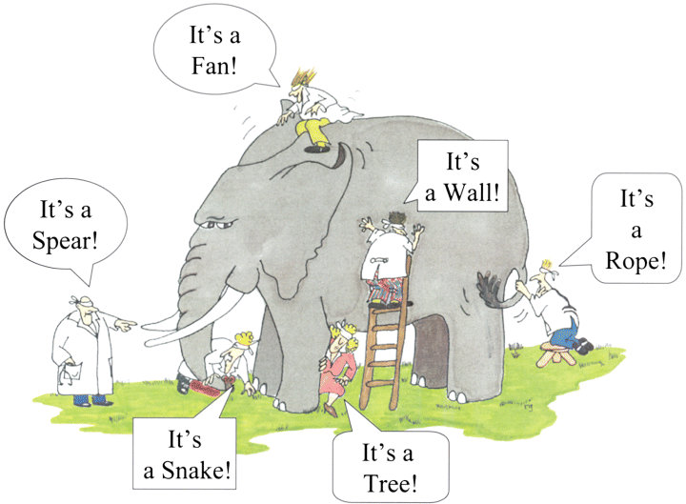

Slide 16
Can anyone see software?

Slide 17
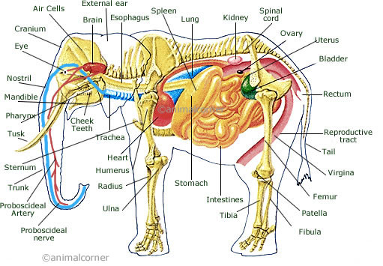
What did all the blind men miss?

Slide 18
What parts of software do we (the blind) “see”?
User: the user interface – buttons, icons, menus, etc.
Programmer: source code
Electrical engineer: semiconductors, transistors, power supply
Society: impact, output, trends, dangers
Business people: profits, costs, required training
Designers: product, structure, architecture
Software project manager: teams, budgets, timetables
Project analyst: design patterns
Professor of software engineering: principles
Students of software engineering: work, work, work

Slide 19
What parts of software do we (the blind) “see”?
User: the user interface – buttons, icons, menus, etc.
Programmer: source code
Electrical engineer: semiconductors, transistors, power supply
Society: impact, output, trends, dangers
Business people: profits, costs, required training
Designers: product, structure
Software project manager: teams, budgets, timetables
Project analyst: design patterns
Professor of software engineering: principles
Students of software engineering: work, work, work
Students of software engineering: opportunity, challenge, fun

Slide 20
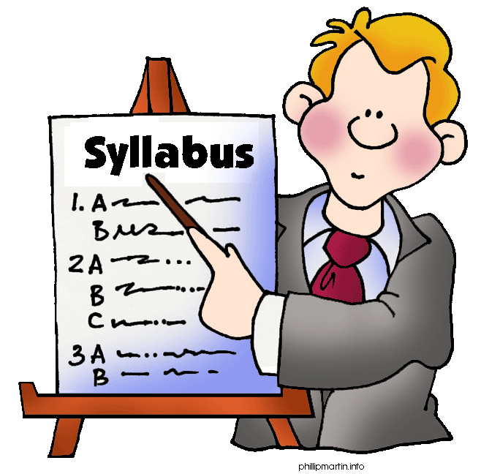
It’s syllabus time!

Slide 21
Back to the blind men and the elephant…
Most students in this class
have used a lot of software, and “see” the user interface aspect;
have done some programming, and “see” the code and algorithms aspect.
But those aren’t the focus of Informatics 43!

Slide 22
No Silver Bullet – Essence and Accident in Software Engineering, by Frederick Brooks
Essence: intrinsic nature
Accident: an unfortunate, unexpected event
Accident: a nonessential attribute; a changeable property

Slide 23
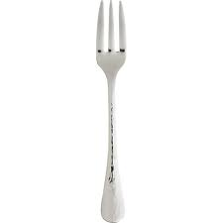
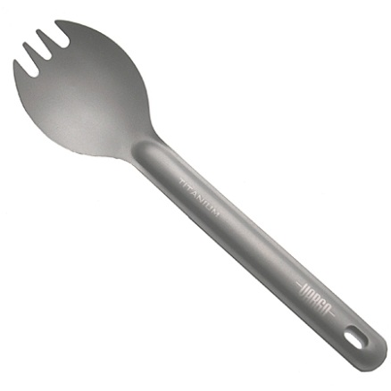
What is the essence of fork?

