Slide 1
Use Cases
Informatics 43 Discussion,
April 8, 2016

Slide 2
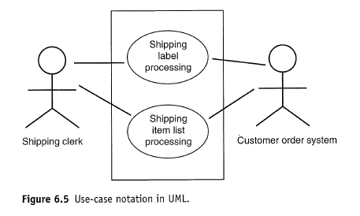
A “use case” diagram, from Tsui, p. 116.
UML, Unified Modeling Language, is a widely used set of diagrams and design tools.

Slide 3
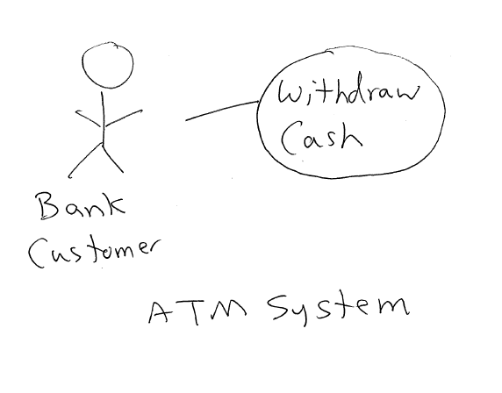
Use Case diagrams can be simple

Slide 4
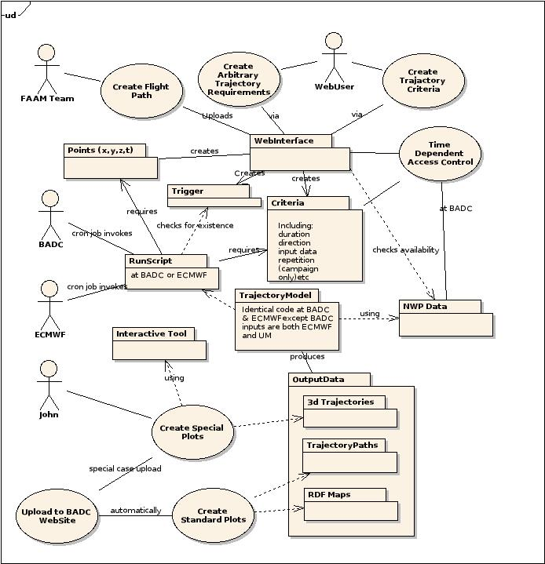
Use Case diagrams can be complex
From http://home.badc.rl.ac.uk/lawrence/blog/2005/11/10/trajectory_support_for_campaigns

Slide 5
Essential features
Use case
association
Actor
Actor can be an external system
Role
System boundary
Too vague! Be concrete!

Slide 6
A Use Case can be much more than a diagram
ID and Name | UC-21 Log In To System
Summary | The student enters his or her unique ID and secret password.
Priority | Essential
Frequency | Always
Actor(s) | Student
Prerequisites | Student is enrolled at the university, has received an ID, and has established a password.
Main Success Scenario | Student types in ID. Student types in password (does not display). Combination is valid, menu of options is displayed.
Alternates / Extensions | Student cannot remember / correctly enter password: Student performs UC-13 Ask For New Password Student enters incorrect password three times: ID is "locked" which means that student cannot log in, even if correct password is entered. Student performs UC-14 Unlock ID And Get New Password. Student cannot remember / correctly enter ID: Student performs UC-99 Go Home And Start Over Next Term.
Notes and Questions | Should ID be locked after three wrong passwords?

Slide 7
From Tsui, 6.3.2 (p. 114)
“A use case is fundamentally a depiction of the following requirement information.”
Basic functionality
Any precondition for the functionality
Flow of events, called a scenario
Any postcondition for the functionality
Any error condition and alternative flow

Slide 8
For Informatics 43 – Keep it simple
We will do simple use case diagrams.
It’s a model - don’t try to make the model do too much.
Focus on the most important activities.
For homework 1: no pictures. Use actor – use case style, e.g.:
Bank customer – withdraw cash
Student – enroll in course
Web user – search by keyword

Slide 9
Exercise
Imagine you are one of the original developers of UCI’s WebSoc.
Work with two or three people sitting near you, and write down 6 to 10 use cases.
Introduce yourselves before you start.

