Slide 1
Inf 43: Introduction to Software Engineering
May 7, 2016

Slide 2
UML Modeling
Diagramming is a language to create an abstract model of a system
Types of Modeling
Functional model
Use cases diagram (behavior diagram)
Object model
Class diagrams (what we are going to talk about, structure diagram)
Dynamic model
Sequence diagrams, state machines etc. (interaction diagram)

Slide 3
Class Diagrams
A class diagram is a diagram showing a collection of classes and interfaces, along with the collaborations and relationships among classes and interfaces
A “class” (as used in object oriented programming and design) is a template for creating objects. Typically a class corresponds to a real world type that has properties/attributes and behaviors/operations.

Slide 4
Class Diagrams
Main Components:
Class
Class name
Attribute
Operation
Relationships (between classes)
Generalization
Association
Aggregation

Slide 5
Class Diagrams: class
Classes can have three parts
Name
Attributes (properties)
Operations (behavior)
Classes can show visibility and types.
Book
Author : string
Title : string
Isbn : number
Archive ()
Borrow (client)
Return()

Slide 6
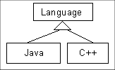
Class Diagram: Relationships
Association
Aggregation
Generalization

Slide 7
Class Diagrams
Customer
1
Rental Invoice
Rental Item
{abstract}
1..*
1
0..1
Checkout Screen
DVD Movie
VHS Movie
Video Game

Slide 8
Class Diagrams
Cardinality
Customer
1
Simple
Aggregation
Class
Abstract
Class
Rental Invoice
Rental Item
{abstract}
1..*
1
0..1
Composition
(Dependency)
Simple
Association
Generalization
Checkout Screen
DVD Movie
VHS Movie
Video Game

Slide 9
Class Diagrams
Class Name
Association Name
+ accessAccount()
Customer
Rental Item
+id:integer
1
Rents
0..n
+id:integer
+name:string
+released:date
Class Diagram
Attributes
Operations

Slide 10
Class Diagrams
class name
properties
access modifiers
CD
CD
getTitle
getRating
match
CD
title
rating
getTitle
getRating
match
CD
-title
-rating
+getTitle():String
+getRating():String
+match(String):boolean
behaviour
parameter lists
return types

Slide 11
Class Diagram Relationships
Generalization
A relationship between a general thing and a more specific kind of that thing.
It is a-kind-of relationship
Shape
Rectangle
Square
Polygon

Slide 12
Class Diagram Relationships
Composition
Combine simple objects into more complex objects
It’s a whole/part relationship.
Diamond filled means the Point lifecycle depends upon Circle. When the Circle is destroyed, so are the Points it is composed of.
Circle
Point

Slide 13
Class Diagram Relationships
Aggregation
Combine simple objects into more complex objects
It’s a weak whole/part relationship.
Diamond not filled means the Contact lifecycle does not depends upon ContactGroup.
AddressBook
ContactGroup
1
0..*
1
0..*
0..*
Contact
0..*

Slide 14
Class Diagram Relationships
Association
Specifies that one object is connected with other
It’s not a whole/part relationship
Weak relationship
Frame
itsParent
Composite
1
Class Composite {
Frame itsParent;
Collection<Shapes>;
}
0..*
itsShapes
Shapes

Slide 15
Class Diagram Relationships
Dependency
Very weak dependency;
Not implemented with member variables at all;
E.g., parameter variable, local variable
DrawingContext
Shape
Draw(DrawingContext c)

Slide 16
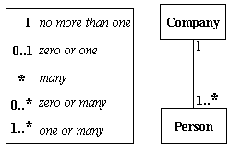
Basic Class Diagram Symbols and Notations
Multiplicity (Cardinality)
Place multiplicity notations near the ends of an association.
These symbols indicate the number of instances of one class linked to one instance of the other class.
For example, one company will have one or more employees, but each employee works for one company only.

Slide 17
Example
(On the white board)

Slide 18
ATM: Requirements
Has a card reader, a customer console, an envelope acceptor, a cash dispenser, a receipt printer, and an operator panel. The ATM will communicate with the bank's computer over an appropriate communication link.
A customer will be required to insert an ATM card and enter a personal identification number (PIN) - both of which will be sent to the bank for validation as part of each transaction. The customer will then be able to perform one or more transactions.
The ATM must be able to provide the following services/transactions to the customer:
cash withdrawal with approval obtained from the bank.
Deposit with approval.
transfer of money between any two accounts linked to the card.
balance inquiry of any account linked to the card.
The ATM will provide the customer with a printed receipt for each successful transaction
The ATM will have a key-operated switch that will allow an operator to start and stop the servicing of customers.
The ATM will also maintain an internal log of transactions
Entries will be made in the log
ATM is started up and shut down
for each message sent to the Bank (along with the response back, if one is expected),
for the dispensing of cash,
for the receiving of an envelope.

Slide 19
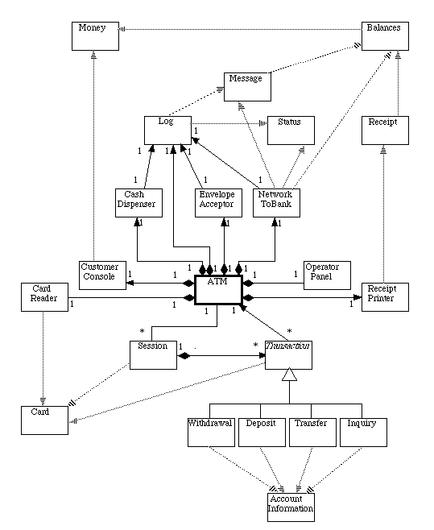
ATM: Class Diagram

