Slide 1
C#
(or B♭)

Slide 2
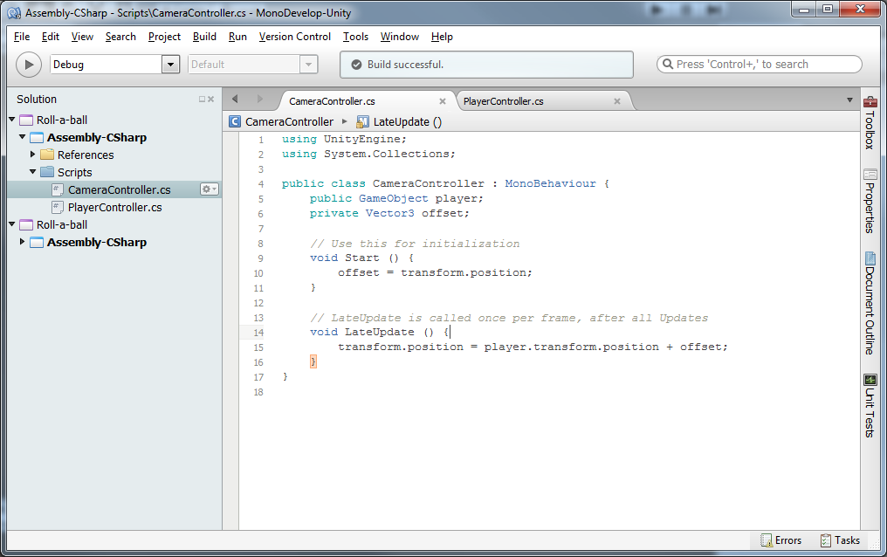

Slide 3
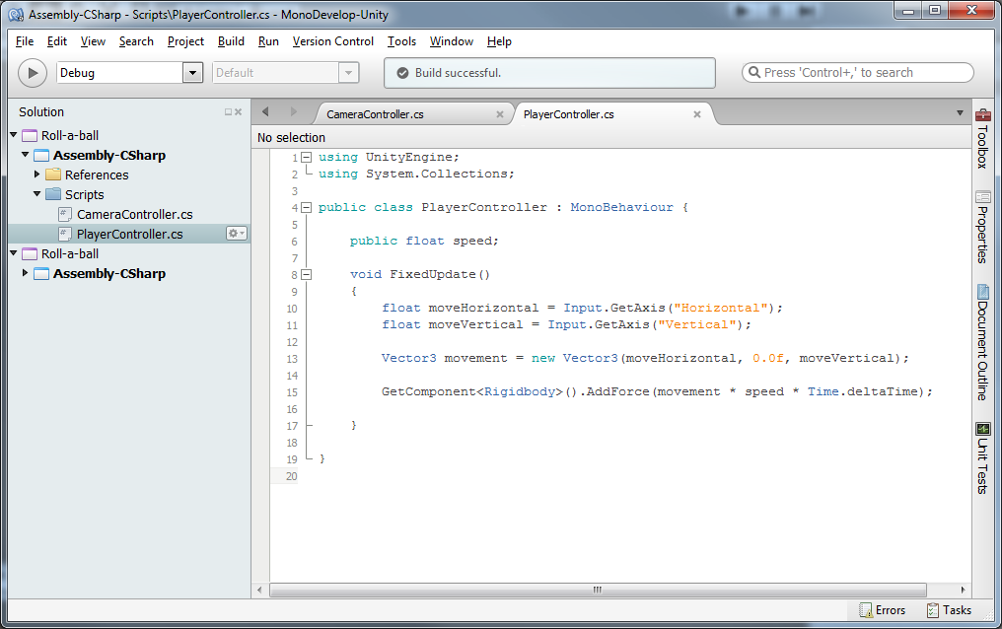

Slide 4
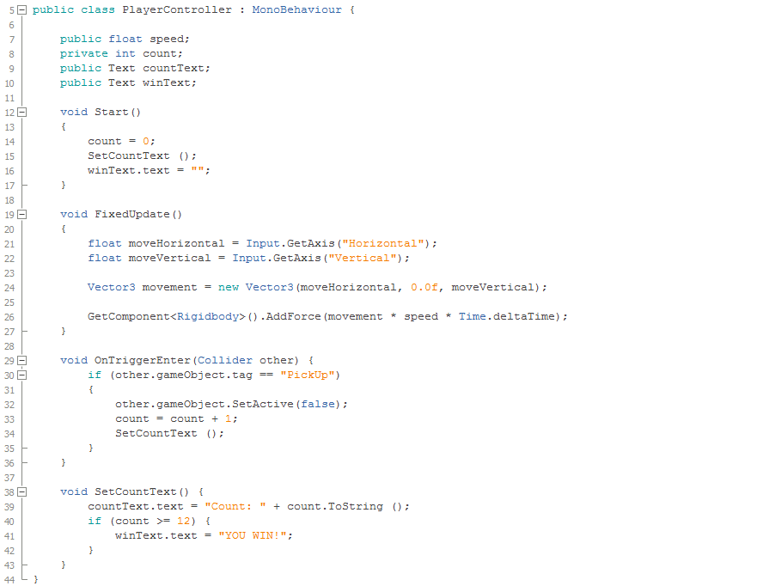

Slide 5
MonoBehaviour and Events
https://docs.unity3d.com/Documentation/ScriptReference/MonoBehaviour.html
http://docs.unity3d.com/Documentation/Manual/ExecutionOrder.html
https://docs.unity3d.com/Documentation/ScriptReference/Time.html

