Slide 1
Artificial Intelligence ICS 62 May, 2016
Dan Frost
UC Irvine
frost@uci.edu

Slide 2
Defining Artificial Intelligence
A computer performing tasks that are normally thought to require human intelligence.
Getting a computer to do in real life what computers do in the movies.
In games: NPCs that seem to be human avatars

Slide 3
Approaches to A. I.
Human Rational
Thinking
Acting
This model from Russell and Norvig.

Slide 4
Systems that think like humans
Human Rational
Thinking like humans “Cognitive science” Neuron level Neuroanatomical level Mind level
Thinking
Acting

Slide 5
Systems that act like humans
Human Rational
Thinking like humans “Cognitive science” Neuron level Neuroanatomical level Mind level
Acting like humans Understand language Game AI, control NPCs Control the body The Turing Test
Thinking
Acting

Slide 6
Systems that think rationally
Human Rational
Thinking like humans “Cognitive science” Neuron level Neuroanatomical level Mind level | Thinking rationally Aristotle, syllogisms Logic “Laws of thought”
Acting like humans Understand language Game AI, control NPCs Control the body The Turing Test
Thinking
Acting

Slide 7
Systems that act rationally
Human Rational
Thinking like humans “Cognitive science” Neuron level Neuroanatomical level Mind level | Thinking rationally Aristotle, syllogisms Logic “Laws of thought”
Acting like humans Understand language Game AI, control NPCs Control the body The Turing Test | Acting rationally Business approach Results oriented
Thinking
Acting

Slide 8
Tour of A.I. applications
Natural language processing – translation, summarization, IR, “smart search”
Game playing – chess, poker, Jeopardy!, video games
Of interest to businesses – machine learning, scheduling
Artificial Neural Networks

Slide 9
Natural Language Processing
Uniquely human
Commercially valuable
Traditional “big” AI research area.
Upper left approach (think like humans)

Slide 10
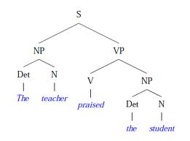
Parse trees

Slide 11
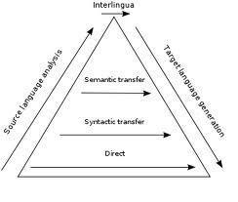
The Vauquois Triangle
prob(eat(cat, fish), 0.9)
eat(cat-species,
fish-species, typically)
S
NP VP
V NP
Les chats mangent
du poisson.
Cats eat fish.

Slide 12
Parsing challenges
I saw a man with my telescope.

Slide 13
Parsing challenges
I saw a man with my telescope.
Red tape holds up new bridge.

Slide 14
Parsing challenges
I saw a man with my telescope.
Red tape holds up new bridge.
Kids make nutritious snacks.

Slide 15
Parsing challenges
I saw a man with my telescope.
Red tape holds up new bridge.
Kids make nutritious snacks.
On the evidence that what we will and won’t say and what we will and won’t accept can be characterized by rules, it has been argued that, in some sense, we “know” the rules of our language.

Slide 16
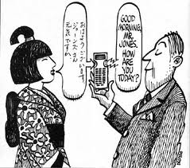
Statistical Approach to NLP
The “Google” way – use lots of data and lots of computing power.
Utilize large corpuses of translated texts (e.g. from the UN).

Slide 18
AI for playing games
Adversarial
Controlled environment with robust interactions.
Tic tac toe, chess – complete knowledge
Poker – incomplete knowledge, probabilities
Jeopardy! – NLP, databases, culture
Video games – the Turing test revisited

Slide 19
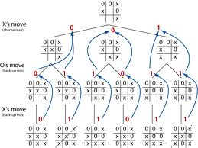
Tic tac toe and minimax

Slide 20
Chess and minimax
Minimax game trees are too big!
10-40 branches at each level
10-40 moves to checkmate
Choose promising branches heuristically.
Evaluate mid-game board positions.
Use libraries of openings.
Specialized end-game algorithms.
Deep Blue beats Garry Kasporov in 1997.

Slide 21
Poker AIs
Bluffing – theory of mind
Betting, raising, calling – making decisions based on expected utility (probability of results and payoffs)
Decision making using Monte Carlo method

Slide 22
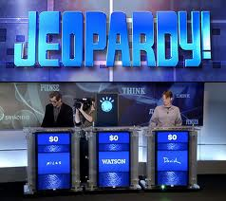
Jeopardy! and IBM’s Watson

Slide 23
How Watson works
Picks out keywords in the clue
Searches Wikipedia, dictionaries, news articles, and literary works – 200 million pages, all in memory
Runs multiple algorithms simultaneously looking for related phrases.
Determines best response and its confidence level.

Slide 24
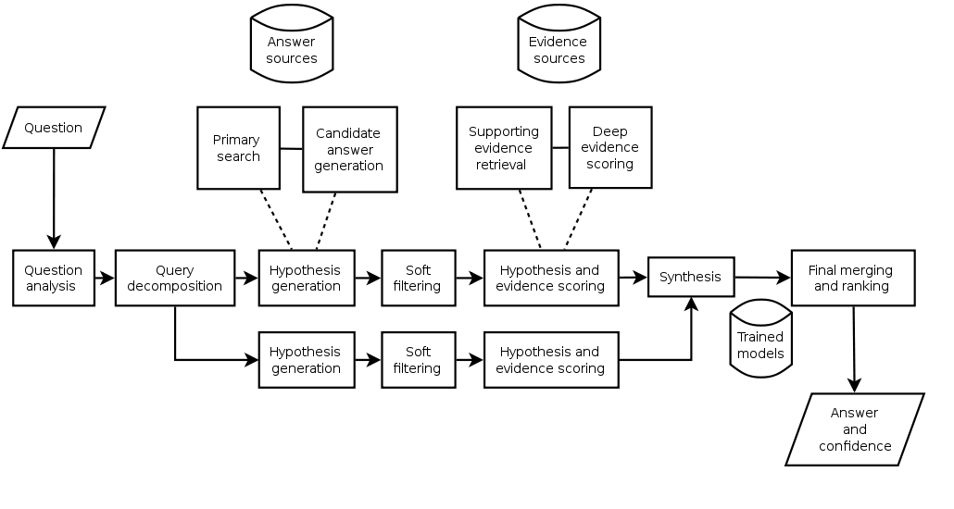
Jeopardy! and IBM’s Watson

Slide 25
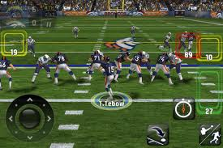
AI in video games – Madden

Slide 26
AI in video games - Halo

Slide 27
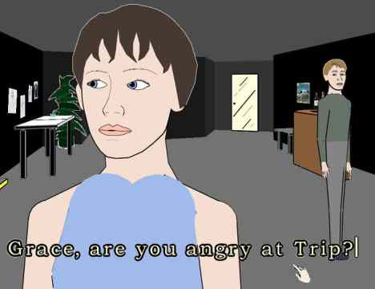
AI in video games – Façade

Slide 28
AI in video games
NPCs (non-player characters) can have goals, plans, emotions
NPCs use path finding
NPCs respond to sounds, lights, signals
NPCs co-ordinate with each other; squad tactics
Some natural language processing
Randomness can be useful

Slide 29
Commercial applications of AI
Machine learning
Mitchell: “A computer program is said to learn from experience E with respect to some class of tasks T and performance measure P, if its performance at tasks in T, as measured by P, improves with experience E.”
Learning often means finding/creating categories.
Scheduling
Often offline, with online updates.

Slide 30
Machine Learning
Induction: learn from observations
Learn a function f from a set of input-output pairs.
How best to represent a function internally?
Input |  |  |  | Output
x1 | x2 | x3 | x4 | f(x1, x2, x3, x4)
0 | 1 | 1 | 1 | 1
1 | 0 | 0 | 1 | 0
0 | 0 | 1 | 0 | 1
1 | 1 | 0 | 0 | 0

Slide 31
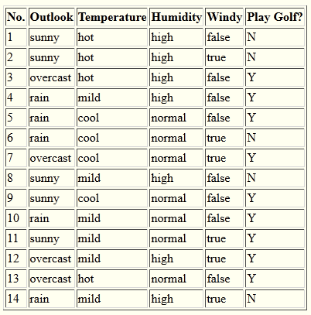
Another classified data set to learn from – should we play golf today?

Slide 32
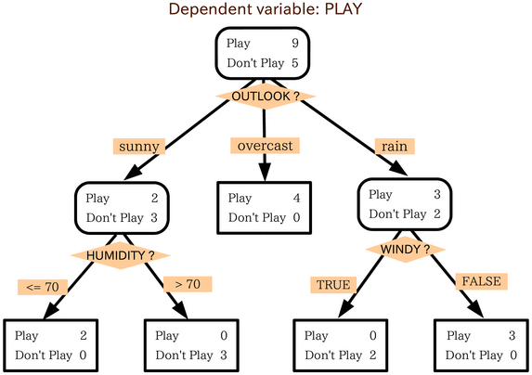
Decision Trees

Slide 33
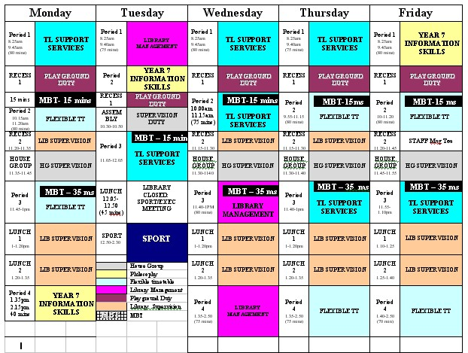
Scheduling / timetabling

Slide 34
Scheduling / timetabling
Courses, nurses, airplanes, factories
Multiple constraints and complex optimization function
Offline – create schedule in advance
Online – revise schedule as conditions change
Local search often works well
Start with an arbitrary schedule
Make small (local) modifications, choose best
Repeat; or stop if no local mod is better.

Slide 35
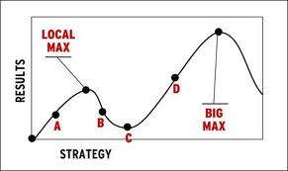
Local search

Slide 36
Recap – Approaches to A. I.
Human Rational
Thinking like humans “Cognitive science” Neuron level Neuroanatomical level Mind level | Thinking rationally Aristotle, syllogisms Logic “Laws of thought”
Acting like humans Understand language Game AI, control NPCs Control the body The Turing Test | Acting rationally Business approach Results oriented
Thinking
Acting

Slide 37
Recap – many A.I. applications
Natural language processing – translation, summarization, IR, “smart search”
Game playing – chess, poker, Jeopardy!, video games – and playing in games (NPCs)
Machine learning, Scheduling

Slide 38
Recap – Approaches to A. I.
Human Rational
Thinking like humans Cognitive science Neuron level Neuroanatomical level Mind level | Thinking rationally Aristotle, syllogisms Logic “Laws of thought”
Acting like humans Understand language Game AI, control NPCs Control the body The Turing Test | Acting rationally Business approach Results oriented
Thinking
Acting

Slide 39
(Artificial) Neural Networks
Biological inspiration
Synthetic networks
non-Von Neumann
Machine learning
Perceptrons – MATH
Perceptron learning
Varieties of Artificial Neural Networks

Slide 40
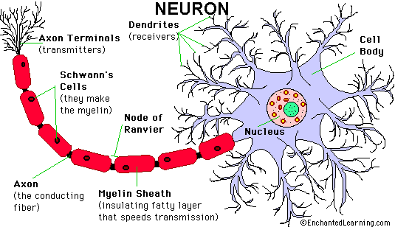
Brain - Neurons
10 billion neurons (in humans)
Each one has an electro-chemical state

Slide 41
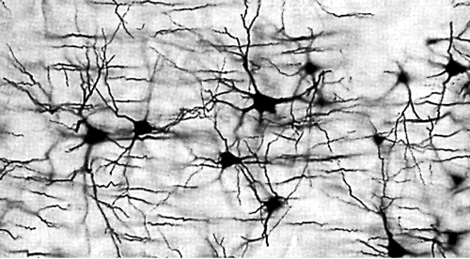
Brain – Network of Neurons
Each neuron has on average 7,000 synaptic connections with other neurons.
A neuron “fires” to communicate with neighbors.

Slide 42
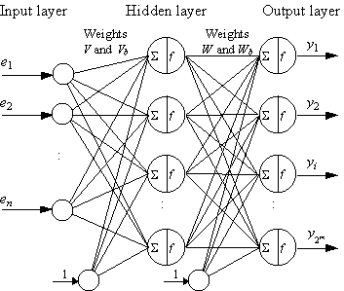
Modeling the Neural Network

Slide 43
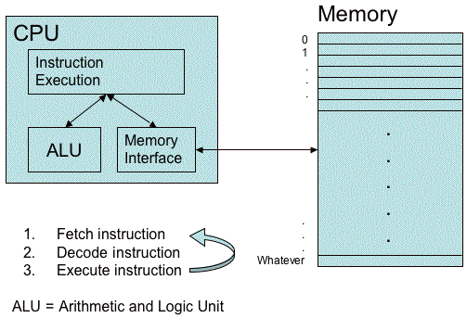
von Neumann Architecture
Separation of processor and memory.
One instruction executed at a time.

Slide 44
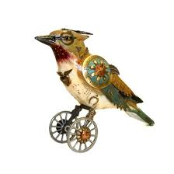
Animal Neural Architecture
von Neumann
Birds and bees (and us)
Separate processor and memory
Sequential instructions
Each neuron has state and processing
Massively parallel, massively interconnected.

Slide 45
The Percepton
A simple computational model of a single neuron.
Frank Rosenblatt, 1957
$f\left(\overline{x}\right)= \left\{\begin{aligned}1 \text{if} \overline{w}∙\overline{x}−b>0 \\ 0 \text{otherwise} \end{aligned}\right.$
The entries in $\overline{w} \text{and} \overline{x}$ are usually real-valued (not limited to 0 and 1)

Slide 46
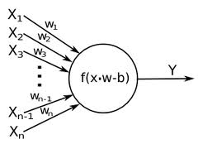
The Perceptron

Slide 47
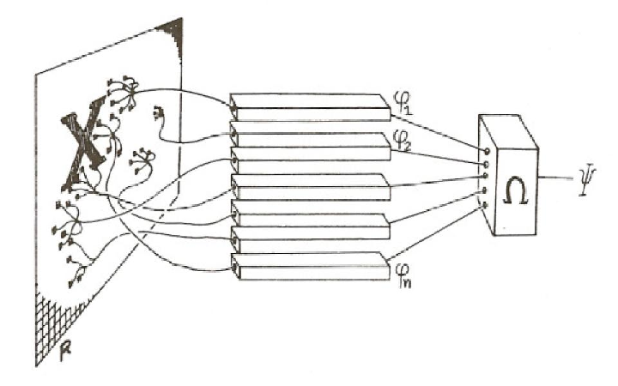
Perceptrons can be combined to make a network

Slide 48
How to “program” a Perceptron?
Programming a Perceptron means determining the values in $\overline{w}$.
That’s worse than C or Fortran!
Back to induction: Ideally, we can find $\overline{w}$ from a set of classified inputs.

Slide 49
Perceptron Learning Rule
Training data:
Input |  |  | Output
x1 | x2 | x3 | 1 if avg(x1, x2)>x3, 0 otherwise
12 | 9 | 6 | 1
-2 | 8 | 15 | 0
3 | 0 | 3 | 0
9 | -0.5 | 4 | 1
Valid weights:
$$w1=0.5, w2=0.5, w3=−1.0, b=0$$
Perceptron function:
$$\left\{\begin{aligned}1 \text{if} 0.5x1+0.5x2 −x3−0>0 \\ 0 \text{o}\text{therwise} \end{aligned}\right.$$

Slide 50
Varieties of Artificial Neural Networks
Neurons that are not Perceptrons.
Multiple neurons, often organized in layers.

Slide 51
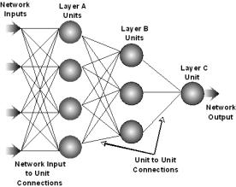
Feed-forward network

Slide 52
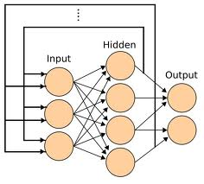
Recurrent Neural Networks

Slide 53
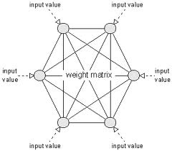
Hopfield Network

Slide 54
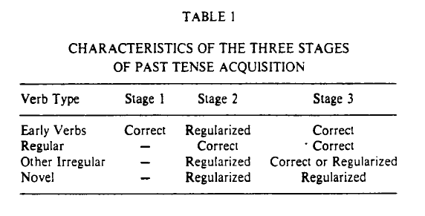
On Learning the Past Tense of English Verbs
Rumelhart and McClelland, 1980s

Slide 55
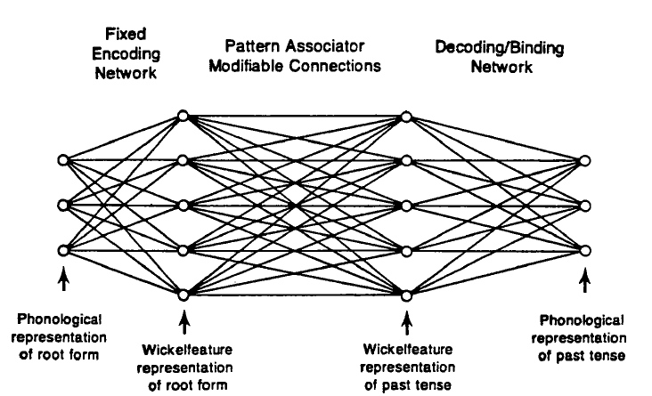
On Learning the Past Tense of English Verbs

Slide 56
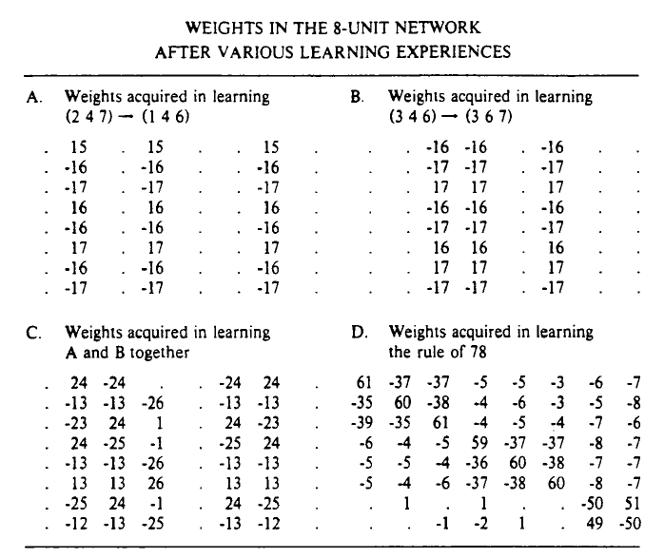
On Learning the Past Tense of English Verbs

Slide 57
Neural Networks
Alluring because of their biological inspiration
degrade gracefully
handle noisy inputs well
good for classification
model human learning (to some extent)
don’t need to be programmed
Limited
hard to understand, impossible to debug
not appropriate for symbolic information processing

Slide 58
Deep learning
Hot and trendy
Wikipedia: “model high-level abstractions in data by using multiple processing layers”
Rebranding of neural networks?
Term introduced by Prof. Rina Dechter at UCI
Used for important persuasive applications: https://www.youtube.com/watch?v=TK4qLwTye_s

Slide 59
All clear?

