Slide 1

Game Programming Patterns Update
Sorry, the audio does not seem to be automatically starting when you go to a new slide. You’ll have to press the “play” icon. (Move the cursor over the speaker icon to see the play icon.)
From the book by
Robert Nystrom
http://gameprogrammingpatterns.com

Slide 2
Much activity that takes place in a game has to be synchronized with the render cycle, so that one quantum of activity happens per frame.
It doesn’t work to move a character without regard to the frame rate. In this example, the skeleton moves (its x value changes), but the player doesn’t see any movement:
while (true)
{
// Patrol right.
for (double x = 0; x < 100; x++)
{
skeleton.setX(x);
}
// Patrol left.
for (double x = 100; x > 0; x--)
{
skeleton.setX(x);
}
}

Slide 3
Of course what we really want to do is move the skeleton once per frame:
// Main game loop:
while (true)
{
if (patrollingLeft)
{
x--;
if (x == 0)
patrollingLeft = false;
}
else
{
x++;
if (x == 100)
patrollingLeft = true;
}
skeleton.setX(x);
// Handle user input and render game...
}

Slide 4
This works fine, so we keep going and put more stuff into the main loop:
// Main game loop:
while (true)
{
// Skeleton moving code from before...
if (++leftStatueFrames == 90)
{
leftStatueFrames = 0;
leftStatue.shootLightning();
}
if (++rightStatueFrames == 80)
{
rightStatueFrames = 0;
rightStatue.shootLightning();
}
// Handle user input and render game...
}

Slide 5
You can tell this isn’t trending towards code we’d enjoy maintaining. We’ve got an increasingly large pile of variables and imperative code all stuffed in the game loop, each handling one specific entity in the game. To get them all up and running at the same time, we’ve mushed their code together.
The pattern to fix this: each entity in the game should encapsulate its own behavior. This will keep the game loop uncluttered and make it easy to add and remove entities.
To do this, we need an abstraction layer, and we create that by defining an abstract update() method.

Slide 6
The Update Pattern:
The game world maintains a collection of objects. Each object implements an update method that simulates one frame of the object’s behavior. Each frame, the game updates every object in the collection by calling every object’s update method.

Slide 7
class Entity
{
public:
Entity()
: x_(0), y_(0)
{}
virtual ~Entity() {}
virtual void update() = 0;
double x() const { return x_; }
double y() const { return y_; }
void setX(double x) { x_ = x; }
void setY(double y) { y_ = y; }
private:
double x_;
double y_;
};

Slide 8
class World
{
public:
World()
: numEntities_(0)
{}
void gameLoop(); // body on next slide
private:
Entity* entities_[MAX_ENTITIES];
int numEntities_;
};

Slide 9
void World::gameLoop()
{
while (true)
{
// Handle user input...
// Update each entity.
for (int i = 0; i < numEntities_; i++)
{
entities_[i]->update();
}
// Physics and rendering...
}
}

Slide 10
Aside:
This approach involves making a subclass of Entity for everything which has a different behavior in the game. Lots of subclassing often leads to problems.
Instead, we could use the Component pattern (in the book, not discussed in class) or the Type Object pattern (discussed in class in January).
For the purposes of simple exposition of the Update pattern, we’ll use subclassing.

Slide 11
class Skeleton : public Entity
{
public:
Skeleton()
: patrollingLeft_(false)
{}
virtual void update()
{
if (patrollingLeft_)
{
setX(x() - 1);
if (x() == 0)
patrollingLeft_ = false;
}
else
{
setX(x() + 1);
if (x() == 100)
patrollingLeft_ = true;
}
}
private:
bool patrollingLeft_; // field not local variable
};

Slide 12
class Statue : public Entity
{
public:
Statue(int delay)
: frames_(0),
delay_(delay)
{}
virtual void update()
{
if (++frames_ == delay_)
{
shootLightning();
// Reset the timer.
frames_ = 0;
}
}
private:
int frames_;
int delay_;
void shootLightning()
{ // Shoot the lightning... }
};

Slide 13
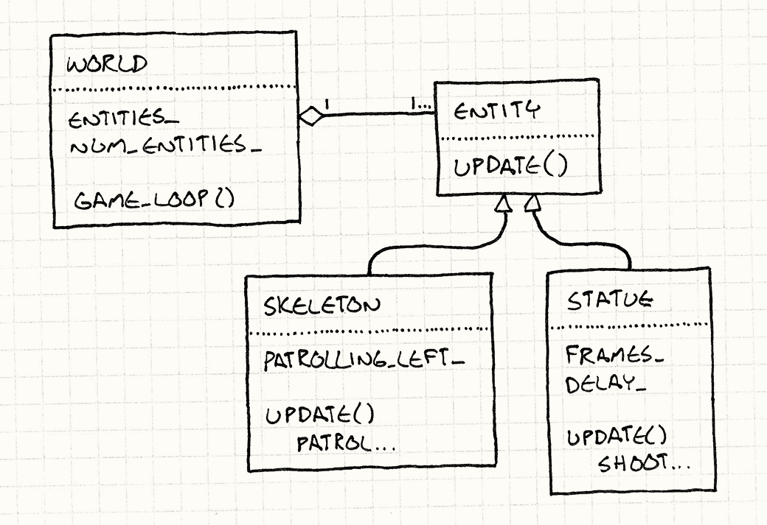
It’s now much easier to add new entities to the game world because each one brings along everything it needs to take care of itself.

Slide 14
Some wrinkles and options:
We can support variable time steps by passing an elapsed time parameter to the update() method.
void Skeleton::update(double elapsed)
If some update() methods add to or remove from the object list, we need to handle this. Perhaps
int numObjectsThisTurn = numObjects_;
for (int i = 0; i < numObjectsThisTurn; i++)
{
objects_[i]->update();
}
Does it matter if A.update() is called before or after B.update()? If we want to control the order of update calls, we need to add some additional logic.
How are dormant (disabled, off-screen, invisible) Entity objects handled? Maybe with an “enabled” flag; or put them into another list.

