Slide 1
Game Programming Patterns Type Object
From the book by
Robert Nystrom
http://gameprogrammingpatterns.com

Slide 2
The game will have lots of monsters, and they come in a variety of breeds, such as “dragon” or “troll”. The breed determines the monster’s starting health, as well as an attack string, which is shown to the player somehow.
The typical OOP answer:
class Monster
{
public:
virtual ~Monster() {}
virtual const char* getAttack() = 0;
protected:
Monster(int startingHealth)
: health_(startingHealth) {}
private:
int health_; // Current health.
};

Slide 3
Now let’s make a couple of breed subclasses:
class Dragon : public Monster
{
public:
Dragon() : Monster(230) {}
virtual const char* getAttack()
{
return "The dragon breathes fire!";
}
};
class Troll : public Monster
{
public:
Troll() : Monster(48) {}
virtual const char* getAttack()
{
return "The troll clubs you!";
}
};

Slide 4
Things start to bog down. Our designers ultimately want to have hundreds of breeds, and we find ourselves spending all of our time writing these little seven-line subclasses and recompiling. It gets worse — the designers want to start tuning the breeds we’ve already coded.
Our formerly productive workday degenerates to:
Get email from designer asking to change health of troll from 48 to 52.
Check out and change Troll.h.
Recompile game.
Check in change.
Reply to email.
Repeat.
We’d like designers to be able to create and tune breeds without any programmer intervention at all.

Slide 5
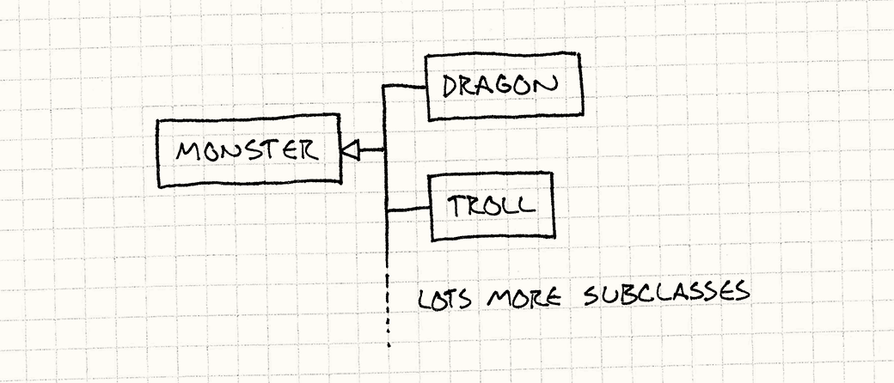
We decided to implement the monster concept using inheritance since it lines up with our intuition of classes.
We ended up with a class hierarchy like this:

Slide 6

That works, but it isn’t the only option. We could also architect our code so that each monster has a breed. Instead of subclassing Monster for each breed, we have a single Monster class and a single Breed class:
That’s it. Two classes. Notice that there’s no inheritance at all. With this system, each monster in the game is simply an instance of class Monster. The Breed class contains the information that’s shared between all monsters of the same breed: starting health and the attack string.

Slide 7
The Type Object Pattern
Define a type object class (Breed) and a typed object class (Monster). Each type object instance represents a different logical type. Each typed object stores a reference to the type object that describes its type.
Instance-specific data is stored in the typed object instance, and data or behavior that should be shared across all instances of the same conceptual type is stored in the type object.
The high-level problem this pattern addresses is sharing data and behavior between several objects.

Slide 8
Some sample code:
class Breed
{
public:
Breed(int health, const char* attack)
: health_(health), attack_(attack) {}
int getHealth()
{
return health_;
}
const char* getAttack()
{
return attack_;
}
private:
int health_; // Starting health.
const char* attack_;
};

Slide 9
When we construct a Monster object, we give it a reference to a breed object.
class Monster
{
public:
Monster(Breed& breed)
: health_(breed.getHealth()), breed_(breed) {}
const char* getAttack()
{
return breed_.getAttack();
}
private:
int health_; // Current health.
Breed& breed_;
};

Slide 10
A slightly different approach is to use the Factory Method design pattern (from the GoF book). This lets us call a “constructor” function for Monster which is part of the class Breed:
class Breed
{
public:
Monster* newMonster() { return new Monster(*this); }
// Previous Breed code...
};

Slide 11
Then we’ll modify Monster to make its constructor private:
class Monster
{
friend class Breed;
public:
const char* getAttack() { return breed_.getAttack(); }
private:
Monster(Breed& breed)
: health_(breed.getHealth()), breed_(breed) {}
int health_; // Current health.
Breed& breed_;
};

Slide 12
What did we just do? Originally, creating a monster looks like
Monster* monster = new Monster(someBreed);
After our changes, it’s like this:
Monster* monster = someBreed.newMonster();
What’s the benefit? None in this simple example.
But in complex games, a lot of work may happen when a new object is created (e.g. bringing in art assets, initializing AI) and avoiding new can give the programmer more control. Also, many big games manage their own memory, and don’t rely on new to find space in memory.

Slide 13
We may want to share attributes across multiple breeds, in the same way that breeds lets us share attributes across multiple monsters. One approach is to add a parent breed to the Breed constructor:
Breed(Breed* parent, int health, const char* attack)
Then we could set up breeds by loading a JSON file:
{
"Troll": {
"health": 25,
"attack": "The troll hits you!"
},
"Troll Archer": {
"parent": "Troll",
"health": 0, // 0 means inherit from parent
"attack": "The troll archer fires an arrow!"
},
"Troll Wizard": {
"parent": "Troll",
"health": 0,
"attack": "The troll wizard casts a spell on you!"
}
}

