Slide 1
Game Engines
Game:
  Engine
  Assets (models, animations, sounds, AI, and physics)
  Code (Rules, AI, Scripting, etc.)

Slide 2
GE161
Includes
  Main game loop, framerate
  Event queue
  2D sprites
  Text
What is missing?

Slide 3
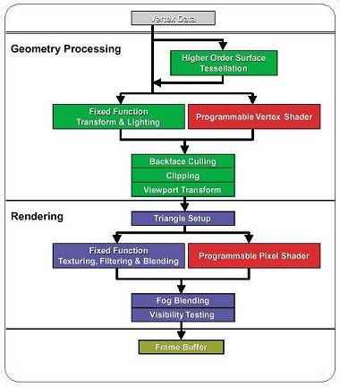
3D Game Engines:
Rendering Pipeline
Application/Scene
    Scene database update/traversal
    Object/Camera Movement/Animation
    Visibility/LOD/Culling
Geometry
    Transforms: Model/World/View
    Viewport & Backface Culling
Triangles
    Scan-line conversion
Rasterization
    Shading
    Texturing/Fog/Alpha
    Depth

Slide 4
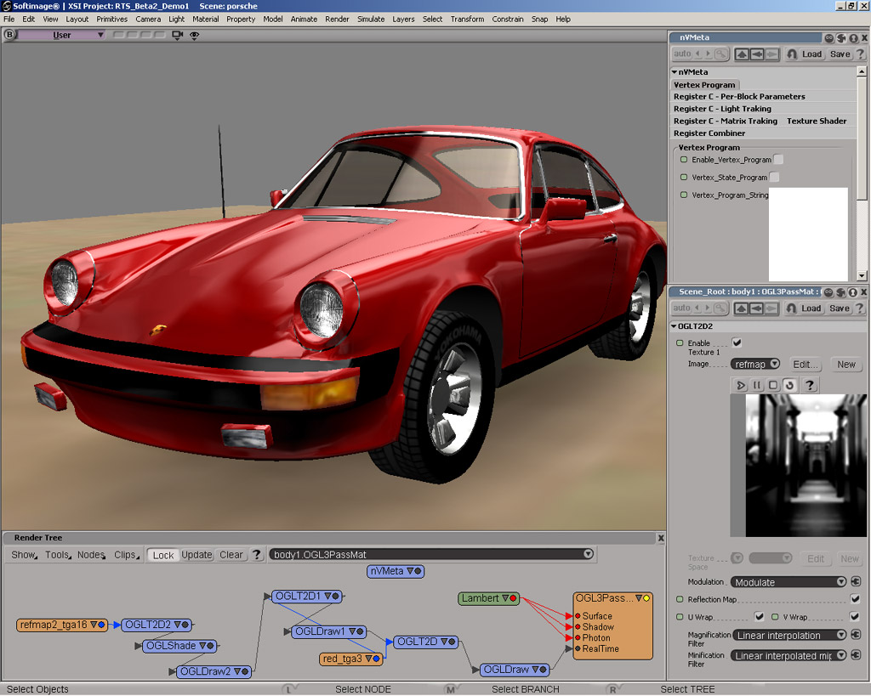

Game Engines:
Shading
Flat
Vertex (Gouraud)
Pixel (Phong)
Light Maps
Programmable (Vertex & Pixel Shaders)

Slide 5
Game Engines:
Memory Management
Cache Thrashing
  Group Primitives by Textures?
  Hardware T&L
  Compression
Card Memory
  Why isn’t 32 bit color (16.7M) enough?
  1280x1024x12 (Front,Back,Z)= 15MB

Slide 6
Engine Considerations
Platforms
Performance
Data
Rendering/Features
Animation
Physics & Environment
Scripting
Authoring
I/O
Save/Load

Slide 7
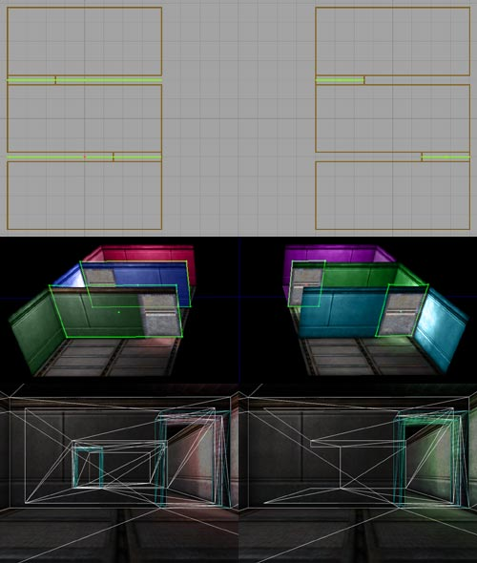
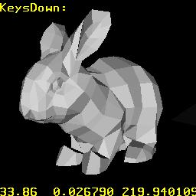
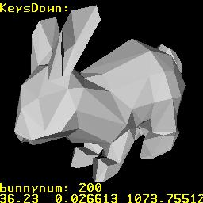
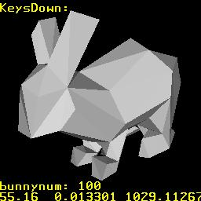
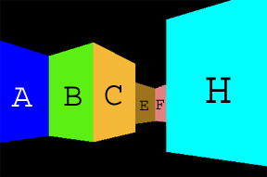
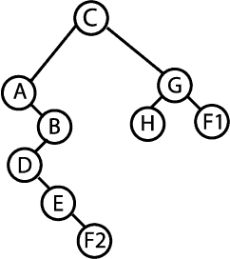
Performance
Occlusion Culling
  Cell Based: BSP tree, Portal, Octree
  Other: Potentially Visible Set, HOM
LOD
Adaptive NURBS/Patches
Polygon Reduction
Terrain Primitives

Slide 8
Data Import/Export
3D file formats
  X, 3DS, MDL, MD2, MAP, WAD
Texture/Image Formats
Models/Animations:
  Maya, 3D Studio MAX
Levels
  WorldcraftT or MilkshapeT
Plugins

Slide 9

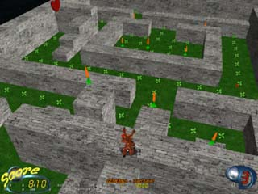
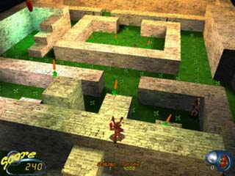
Rendering
Features
OpenGL vs. DirectX
  DX6-9
  OpenGL1.1-1.5,2.0
Shadow Maps (Lightmaps)
Shaders
Dynamic Shadows
MIP Maps/Multi Maps/ Bump Mapping
Effects

Slide 10
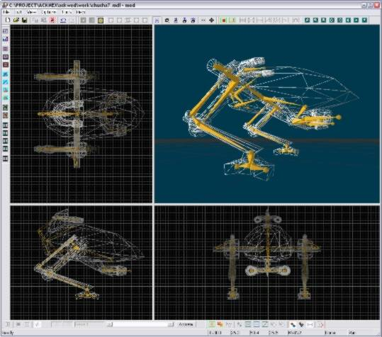
Animation
Keyframe
Bones (Skinning)
Facial Animation
Vertex Animation
Inverse Kinematics (IK)
Dynamics
High-level Authoring

Slide 11
Physics & Physical Environment
Visibility
Collision Detection
Terrain Following
Gravity
Physics
  Rigid & non-rigid bodies

Slide 12
Scripting
Scripting languages add logic for controlling actors or objects
Languages:
  Javascript
  Luo -http://www.lua.org/
  Python
  Basic
  Custom:UnrealScript, C-Script, etc.
Script Compilers for performance

Slide 13
Save/Load System
allows the end user to save a complete game state.
'freezes' all running scripts and all objects and variables of the game and writes them into a file
Without such a system:
  a script has to be written which stores the state of every variable and object and the position within every script function

Slide 14
Authoring/Editing
Level Editor
Model Editor
Script Editor
Terrain
Logic

Slide 15
GE161
What is missing?
  3D support
  Memory management, Multi-threading support
  Scripting, Authoring
  Save/Load
  Physics
  High performance data structures
  Data Import and Export
  Middleware integration (beyond SDL)

Slide 16
GE161
What is missing?
  Networking
  Sound

